Slide 1
ma]v Akp<tftk pad utvi EcafkfAk
']f 1 Mtlf 36 vAr
ptiqfkqf `qikfkpfpdfd[
THE BIBLE…BASICALLY MINISTRIES INT’L INC. Multiplying Biblical Literacy Throughout The Body of Christ
Ft. Worth, Texas www.biblebasically.com
53
Notes:
Still has some English on:
Master slide headers and footers
Slide 1 Multiplying Biblical Literacy Throughout The Body of Christ
Slide 9 footer
Slide 21 footer
Slide 26 header and footer
Slide 27 footer
Slide 36 Revelation 19-22 events
Slide 39 footer
Slide 40 footer
Slide 41 footer
Slide 42 footer

Slide 2
ma]vafkQkfK:
;pfpad utvi , pirti u]fdakfkv<mf , pvafAp[fdf YMlmf opfpAdkfkv<mf utv<mf.
ovfevaR vKpfpiLmf , caiya[ pad utviAy upEyakikfk pvafAp[fdf "TvakyiRkfkibT.
uqfYQaf pirti u]fdakfKtL.
Pad Kbipfp< ']f 09/09`
+
26/26`
O[fBkfK pi[f o[fba[ pkfkmf
53

Slide 3
fpad utvitftidfd EcafkfAk
;Av namf vKpfpilf py[fpDtftPFy pad utvi tidfdmf.
'lfla kaliya[ ;dgfkAqy<mf p>aftfti ecyfy ubffcakpfpDtfTkiEbamf. ;vfvKpfpi[f EnakfkgfkQmf, ugfkqf pgfKkqi[f YMlMmf, kbfBeka]fd padgfkqf ugfkQkfK pirEyaj[mayiRkfKmf.
nIgfkqf klnfT eka]fdAmkfK n[fbi. ugfkqf EvAlkA[ ~cIafvtipfpaaf '[ vc[mf kbfBekaDkfkibT. ;pfpadtftibfK pibfpaD Etv{Ady opfpilfla vaaftfAtyi[f nmfpkfPFy t[fAmy<mf, `FpfpAd kar]Mmf, Mr[fpaFlflat t[fAmy<mf, niyayma[ `Ampfp<mf, ;A[ybfb ~tfmIk t[fAm Kbitfta[ ']f]gfkqf mBmlafcfci epbfBeka]fFRpfpIkqf.
Ugfkqf nmfpikfAkAy KbitfT EkdfD vicaaipfpvafkQkfK, ~ytftpfpdfdvafkqak Etv{Ady vaaftfAtAy opfp<vikfk, nIgfkqf cadfciyi[f kRvikqayiRpfpIkqf!”
53

Slide 4
_{pad utvi Kbipfp<}
pKti o[fB
01 p7`; pyiafcfcitazf:“;gfkibinfT ~rmfpmakibT.”
02 p7`; vi[a tazf
03 Evtakm kdfdgfkqi[f cikicfAc : kali
04 Evtakm vaiAcyi[f `dfdvA[: kali
05 `Amtiyi[f kalmf: mlfkiyaviliRnfT mtfEty< vAryiLmf
06 `Amtiyi[f kalmf: mik kF[ma[ catA[
07 ;EyC pirya]mf ecyft MdfecFyi[f vzi
08 Evtakmtfti[f kdnft kal enyfy<tlf
09 Evtakm kdnft kalmf pqpqpfp< `dfAd MAb
10 “pavmf” '[fb vaaftfAt
11 Etv[i[f mkiAmya[ nammf
12 o[fBkfK o[fbak mabfb PFy na[fK vaaftfAtkqf
13 plgfkaltfti[f ud[fpFkfAkyi[f ubv<kqf
14 ~pirkamibfK ekaDkfkpfpdfd ~ti vakfKtfttftgfkqf
EmaEc ud[fpFkfAkyi[f tbfkalik "bfpaD
16 ;EyC kibisfTvi[f vmfc vrlaB
17 ;EyC kibisfTvi[f pibpfp<mf, vazfvibfka[ nmfpkfPFy p<lfli vivrgfkqf
18 “tibnft” Evtmf: kali
19 pAzy "bfpadfAd "bfpDtftlf: kali
20 p<tiy "bfpadfF[f p<tftkgfkqi[f vaiAc: kali
21 kaftftrakiy ;EyC kibisfTvi[f MFnft vR[A[
22 Eyava[i[f CviEcxmf: piaikfkpfpdfd CviEcxmf
23 `pfEpasftftlai[f ndpFkfAk: M[fB pak kAt
24 pv<lf: `vai[f pirya[gfkqi[f k]fE[adfdmf: kali
pv<li[f ;r]fD Mkfkiy ;byiylf
26 “kFtgfkqf”Mkfkiy kBpfepaRqf ( 26`)
evqipfpDtfti[ viEcxmf: jnfT `Acyat Kbipfp<kqf
Evtakmtfti[f niAbEvaiy Enakfkmf: ;EyC kibisfT
29 p>aftftiecyft m{tftazf `biMkmf
30 Evtakm kdfdgfkqi[f cikicfAc : p>aftfticfecyfypfpdfd[
31 Evtakm vaiAcyi[f `dfdvA[: p>aftfticfecyfypfpdfd[
32 ~pirkamibfK ~ti vakfKtfttftgfkqf : p>aftftiecyfypfpdfd[
33 tibnft” Evtmf : p>aftftiecyfypfpdfd[
34 pAzy "bfpadfAd "bfpDtftlf : p>aftftiecyfypfpdfd[
35 p<tiy "bfpadfF[f p<tftkgfkqi[f vaiAc : p>aftftiecyfypfpdfd[
36 pv<lf `vai[f pirya[gfkqi[f k]fE[dfdmf :p>aftftiecyfypfpdfd[
pKti ;r]fD
pKti M[fB
pKti na[fK
pKti jnfT
pKti ~B
pKti "Z
pKti 'dfD
p<>aftftiecyfypfpdfd TA] pKti
55

Slide 5
01
;gfkiRnfT ~rmfpimakibT…
J
C
;
p
7
`
7
S
pAdpfp<
`Amti
;EyC
4
m[itaf :
~pirkamf
~
~pirkamf
EyaEcpfp<
Eya
EyaEcpfp<
EmaEc
Ema
EmaEc
EyaCva
Eya
EyaCva
3
cgfkgfkqf :
`
`rci[fAm
`rci[fAm
r
raj ptvi
raj ptvi
`
`FAmtft[mf
`FAmtft[mf
ugfkqf m[ti[f Evtakm kakit EkaAv!

Slide 6
02
;pfEpaZT…ugfkqf m[ti[f Evtakmf kakit EkaAvAy tibv<gfkqf. ugfkqf YMlEma, `lflT TvarmiDmf YMlEma, `lflT mbfbvafkqidtftilf vi[akfkqi[f YMlmf tibkfklamf
ugfkqf Evtakm kakit EkaAvyi[f tibv<kfEkaqf:
“p” '[fb 'ZtfT 'tA[ KbikfkibT '[fbalf:
p 7 ` ;
pAdpfp<
7 = 4+3 piaiki[fb `mfcgfkqf:
4 m[itaf & 3 cMtaygffkqf
`nft na[fK m[itafkqf yaer[fbalf:
~pirkamf EyaEcpfp< EmaEc EyaCva
Then…call out the group, leaving out one. Answer is ?
The THREE SOCIETIES are:
`rci[fAm raj ptvi `FAmtft[mf
Also…call out the group, leaving out one. Answer is ?
“`” '[fb 'ZtfT 'tA[ KbikfkibT '[fbalf::
pAdpfp<
`Amti
~pirakmf
“;” '[fb 'ZtfT 'tA[ KbikfkibT '[fbalf::
EyaEcpfp<
;EyC
EmaEc
~t[alf, ptfT vaaftfAtkQmf…ugfkqf ptfT kakit EkaAvyi[f `Adyaqgfkqf :
EyaCva
ugfkqf m[ti[f Evtakm kakit EkaAv!
`rci[fAm
raj ptvi
`FAmtft[mf
`Amti
;EyC

Slide 7
03a
Evtakm niAlAy `Amtftlf
(;vfvKpfpi[fEpaT vAry ;pfpkfkmf kaliyak vidpfpdfd[)
m.k
ni
~
k
k.k
pa
'
En.m
_.n
'
(u).k
u
k.p
p.v
cI.m
ecylfpaF[f
“
ci.m
paAtkqf ”

Slide 8
03b
Evtakm niAlAy `Amtftlf
(;vfvKpfpi[fEpaT vAry ;pfpkfkmf kaliyak vidpfpdfd[)
m.k
ni
~
k
k.k
pa
'
En.m
_.n
'
(u).k
u
k.p
p.v
cI.m
ecylfpaF[f
“
ci.c
paAtkqf ”

Slide 9
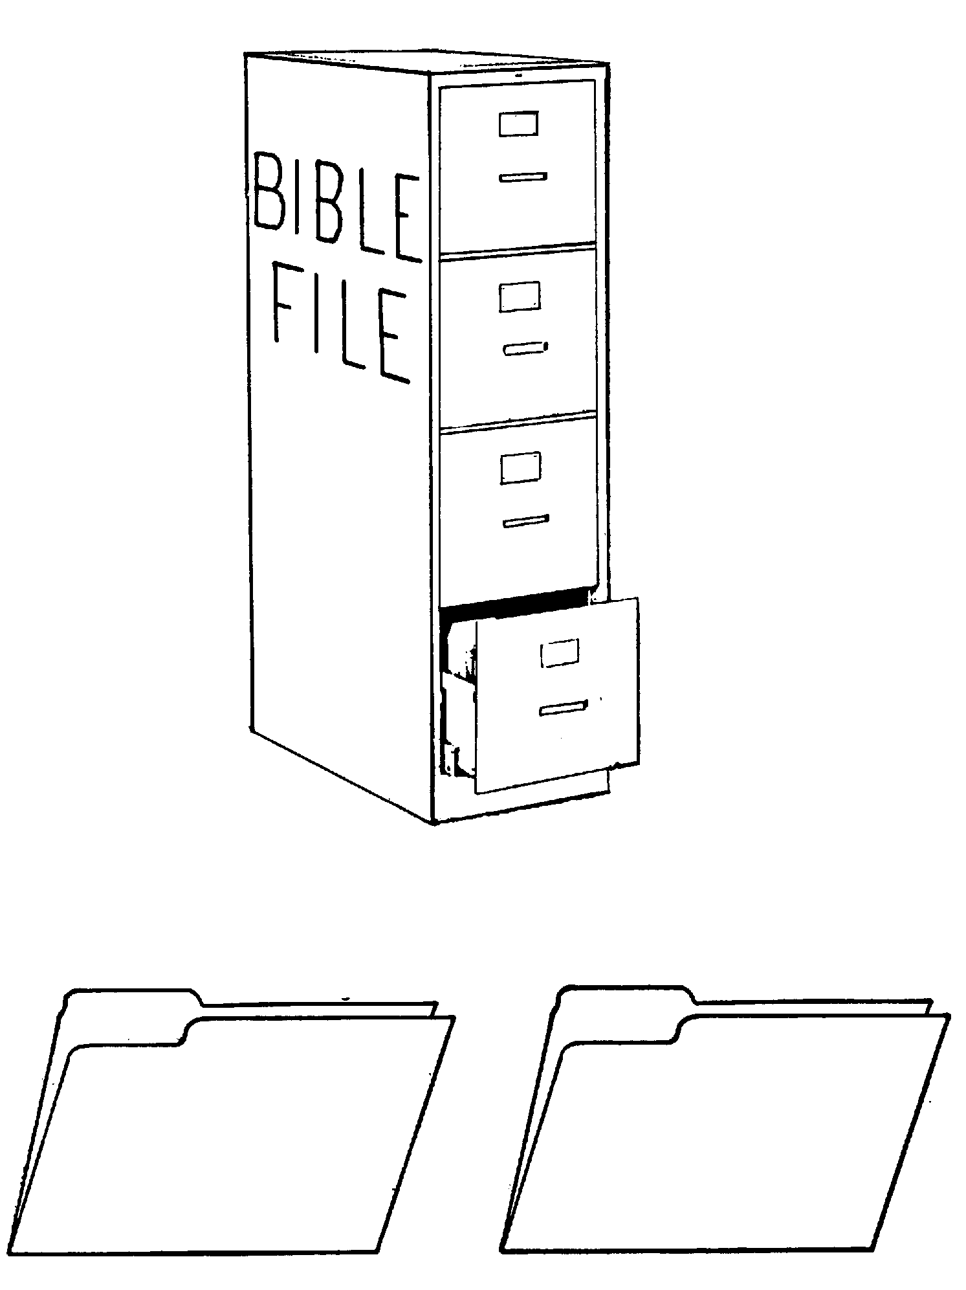
04
Evtakm kakit EkaAvyi[f KbipfpiDtlf
pAdpfp<
`rci[fAm
1mf ~]f & ep]f
niyatiptikqf
1mf pavmf
350
p
1mf upEtcmf
p
7
` ;
1mf KDmfpmf
rajpf ptvi
(1000 ki. M.)
1mf ekaAl
S - D - S
_{DC}
evqfqmf/va[vilf
••• pirinft[•••
EkadfAd
vdkfK etbfK
~pirkamf
(2000 ki.M)
;sfrEvlf y<>ta
`Azpfp<
_{AC}
10 2
_{NC}
L - S - B
tIafkfktaici
I - I
20-J 20-R
3 cMtaygfkqf
200 350
J - E
`ciaiya papiEla[f
12
EyaEcpfp<
`FAmtft[mf
70 vRdgfkqf
`FAmtft[mf
3 pirya]mf
430
100 vRdgfkqf/50,000
Z - E - N
EmaEc
(1500 ki. M)
`Amti
yatftirakmmf
`
(500 B.C.)
4 m[itrfkqf
kiErkfkiy `elkfsf
cI[ayf
Eram Mabkqf
M - C - C
_{kaEdxf prf[iya}
;EyC
40
_{LC}
vazfkfAk
5 upEtcmf
;
ciLAv
_{EyaCva}
tiRcfcAp
upEtcmf
_{'aiEka / ~yf}
`pfEpasftftlaf
_{Etcmf pKkfkpfpdfd[}
niRpgfkqf
evliipfpDtfti[
CviExcmf
THIS PAGE, INCLUDING THE COPYRIGHT NOTICE, MAY BE REPRODUCED LOCALLY FOR STUDY AND TEACHING PURPOSES.

Slide 10
05
`Amtiyi[f kalmf
mlfkiyaviliRnfT mtfEty< vAr
`elkfca[fdaf , ki. M 300mf ~]fdilf, 33 vytilf kalma[aaf
`vai[f camfpirajiymf epaTvak na[fK pKtiyak piaikfkpfpdfFRkfkibT
kiaisf
~ciya Am[af:
kaec[fdaf
AlciemkfKsf
cIriya:
Ecliy<cidf Eprarcafkqf
_______
ecliy<Csf
Mtftiy tAr kdlf
p>Elaktfti[f napif
plsftI[a
'kipfT
pfEtalmakiy parfEva[f
______
pfEtalmi
`t[f pibfpaD… Eramaf kaltftilf :
mka `elkfca]fdai[f ckapftftmf
`rcagfk niafvakmf
;ynftirmf…nIafcf ckfkrmf upEyakitftlf
tiaiEka] miti uRvakfKtlf
nIaf kFkarmf
eraecdfda klf ecTkfKtlf
`elkfca]fFiriya :etazilf Ndfp klfLai
Eram vgfki MAb
p<tiy kdfDma[ MAb
nIaf/ cakfkAd MAbkqf : ka[fkiaidf
pgfK cnfAt
`klma[ enDwfcaAl MAb
vRdtftil f365-naqf MAbAy pi[fpbfBtlf
epkIsf Erama[a
Eramaf – plsftftI[aAv ~kfkirmitftlf
`aisfEdadfdlf :`elkfca]fdai[f ~ciaiyaf
`aisfdfEdadfdlf: ;Ac vilkfkmf
cI[avi[f mka Cvaf
cI[avilf ;Rmfp< upEyakitftlf
`elkfca]fFaiya: kiErkfk klfvi Amymf
y<kfkilidf: EXtftir k[ittftilf Mabya[ EvAlyaD
Mtlf Eram na]ymf
ekaainfT, Mtlf vaftftk Amymayi[
'kipftilf, y>t vaftftk Amymf
Ehlfl[icmf : kiErkfk Epa[fb pdfd]mf kiErkfk Epa[fb vazfkfAk

Slide 11
06
`Amtiyi[f kalmf
mlfkiyaviliRnfT mtfEty< vAr
mka kF[ma[ niAbEvbfbqff:
Evt `FpfpAd:
1. 'piery casftiaI vti ( pAzy "bfpaD) MFv<bfb[.
2. pAzy "bfpaD , kiErkfk emaziyilf emazipfepyafkfkpfpdfd[. (ecpfDj[fdf – Kbipfp< p<tftktftil “LXX”
caitftirmf:
3. mka `Elkfca]fdaf Akpfpbfbiy 'lfla EtcgfkqiQmf, exl[icmf '[fb nmfpikfAkAy prpfpi[af .
4. Eramafkqf plsftftI[aAv `rca]fdaafkqf :ka]pfpdfd ulktftilf mik cibnft etazilf NdfpMmf, ekaDrma[ cmata[Mmf ekaFkfkdfFy kalmf
…~pirkaMkfK Etv[f `litft pirta[ vakfKtfttftgfkqf niAbEvr niAlkAq ecylfpDtft vzivKtft[….
Emciyavakiy kaftftrakiy ;EyC kibisfTvi[f Etabfbmf!

Slide 12
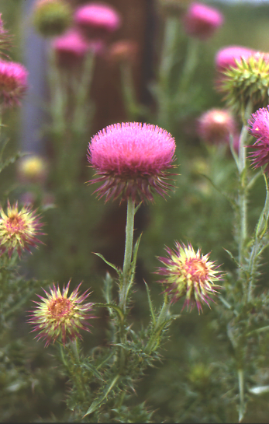
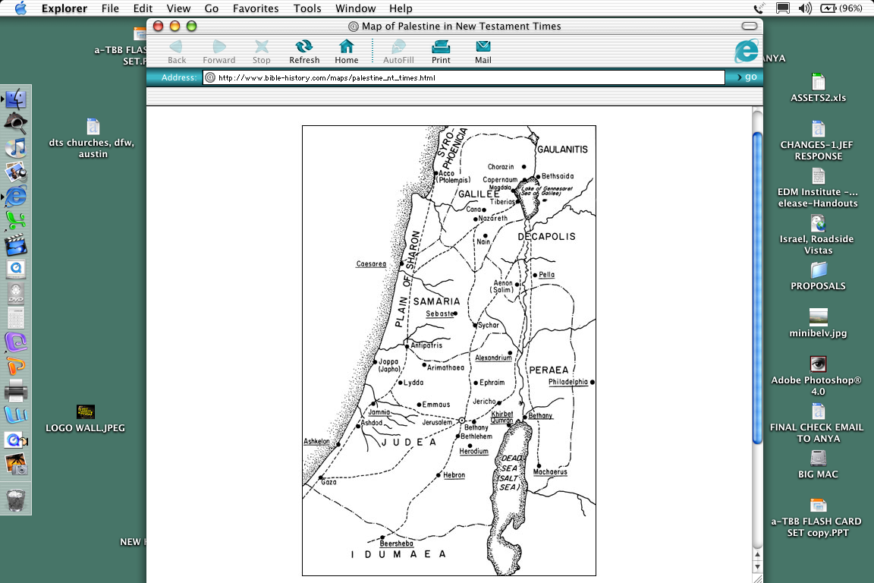
07
;;EyC pirya]mf ecyft MdfecFyi[f vzi
3
kpfpafnPmilf pirta[ kliElya Uziymf
kpfpafnKmf
kliElya
4
2
cmaaiya
epaiy[f Uziymf
cCmaaiyavilff pirta[ mabfBtlf
5
1
'RcElmilf ;Bti Uziygfkqf
'RcElmilf kaftftai[f uziymf ~rmfpmaKtlf
’
'RcElmf
’
’
Yy<Etya

Slide 13
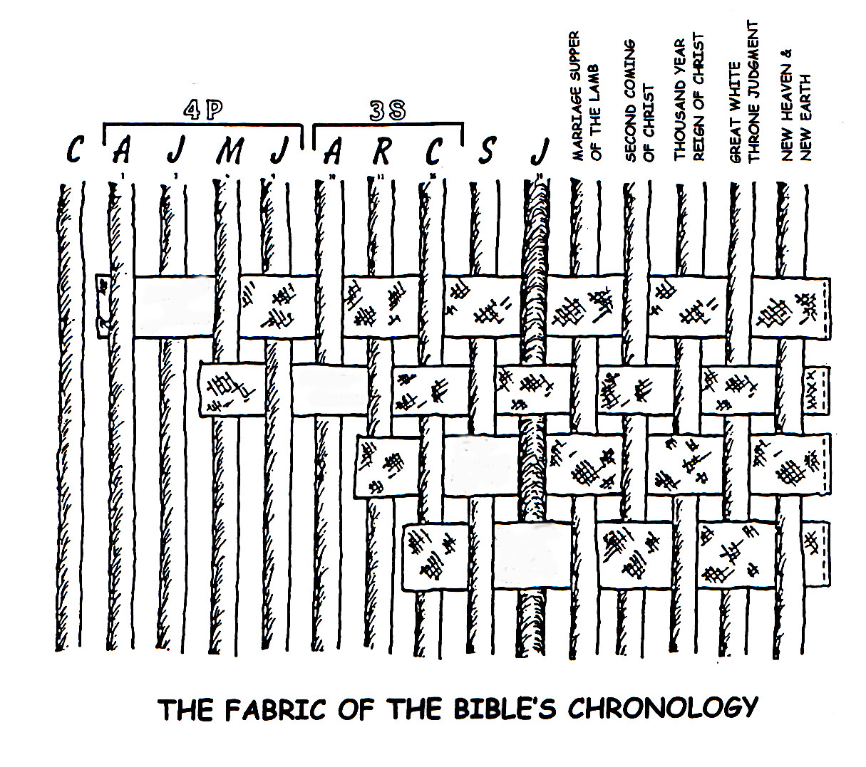
08
Evtakmtfti[f kdnft kal enyfy<tlf
p 7 ` ;
~pirkami[f ud]fpFkfAk
Etc ud]fpFkfAk
tavIti[f ud]fpFkfAk
p<tiy ud]fpFkfAk
~pirakMkfK ekaDkfkpfpdfd vakfKtftgfkkqf niAbEvaikfeka]fFRkfKmfEpaT, Evtakm cmfpvgfkQmf M[fE[bieka]fFRnftT:
•~pirkami[f `AztftLmf, ~tiyakmmf 12 , 15 ud[fpFkfAky<mf
• upakmmf 30lf,Etcmf ( plsftftI[a) ud[fpFkfSky<mf
• 2 caMEclf 7 lf, tavIti[f ud[fpFkfAky<mf
• 'Ermiya 31lf, p<tiy ud]fpFkfAky<mf.

Slide 14
08

Slide 15
09
Evtakm kdnft kalmf vivrikfKmf
pqpqpfp< `dfdAd MAb
;T M[f{mf pi[f{mf `cfcidpfpdfd pkfkmf. ovfevaR `dfAdy<mf pakgfkqak evdfF, ma]vafkqf Evtakm kakit EkaAvyilfLqfq uqfqdkfkgfkAq 'ZTk.
_________
kal tikti
_____ ki.M
kal tikti
_____ ki.M
kal tikti
kal tikti
_____ ki.M
kal tikti
_____ ki.M
_____ ki.M
EmaEc
pAdpfp<
~pirkamf
EyaEcpfp<
EyaCva
Evtakmmf… `FpfpAd
Evtakmmf… `FpfpAd
Evtakmmf… `FpfpAd
Evtakmmf… `FpfpAd
Evtakmmf… `FpfpAd
®
®
®
®
®
kal tikti
_____ ki.M
kal tikti
_____ ki.M
kal tikti
_____ ki.M
kal tikti
_____ ki.M
kal tikti
_______
_______
raj ptvi
;EyC
`rci[fAm
`FAmtft[mf
`Amti
Evtakmmf… `FpfpAd
Evtakmmf… `FpfpAd
Evtakmmf… `FpfpAd
Evtakmmf… `FpfpAd
Evtakmmf… `FpfpAd
®
®
®
®
®
Ekqfviyi[f pkfkmf

Slide 16
09
Evtakm kdnft kalmf
pqpqpfp< `dfdAd MAb
;T M[f{mf pi[f{mf `cfcidpfpdfd pkfkmf. ovfevaR `dfAdy<mf pakgfkqak evdfdif, ma]vafkqf Evtakm kakit EkaAvyilfLqfq uqfqdkfkgfkAq 'ZTk.
kal tikti
kal tikti
kal tikti
2000 ki.M
kal tikti
'lfla kalm
~lirkamibfK M[fp<
1500 ki.M
1500 ki.M.
2000 ki.M
EmaEc
AC
yatftirkammf
pAdpfp<
cI[ayf
1mf ~]f & ep]f
EyaCva
M - C - C
EyaEcpfp<
~pirkamf
1mf pavmf
'aiEka/~yi
kaEtsf prf[iya
`FAmtft[mf
`Azpfp<
1mf upEtcmf
Nilmf piqv<pdfdT
40
430
L - S - B
1mf KDmfpmf
5 pircgfkmf
I - I
1mf ekaAl
J - E
evqfqmf/va[vilf
LC
12
EkadfAd
kal tikti
Mtlamf Nabba[fD
500 ki.M.
500 ki.M.
1000 ki.M
kal tikti
kal tikti
kal tikti
1000 ki.M
kal tikti
DC
NC
;EyC
raj ptvi
vazfkfAk
S - D - S
ciLAv
`Amti
`diAmtft[mf
••• SPLIT •••
`rci[fAm
tiRcfcAm
Alex the Greek
70 vRdgfkqf
vdkfK etbfK
niyayatiptikaf
upEtcmf
Roman Systems
3 pirya]mf
;sfrEvlf y>ta
350
`pfEpasftlaf
100 vRdgfkqf / 50,000
10 2
niRpgfkqf
Z - E - N
tIafkfktaici
evqipfpDtfti[ CviExcmf
20-J 20-R
200 350
`caiya papiEla[f
ptilf uqfEq

Slide 17
10
Evtakm evqipfpDtfTtli[f “ mTkfekZmfp<” :
Etv[i[f nipnftA[ybfb ud[fpFkfAkyi[f tidfdgfkqf
“pavmf” '[fb vaaftfAtAy KbitfT
kiErkfk, 'pieryailf : ~gfkil vaaftfAtyilf pavtftibfK pl `aftftgfkqf PbpfpdfFRkfkibT: oZkfkmfmilflaAm, `kfkirmmf, mIRtlf, plvI[gfkqf, Kbfbgfkqf mbfBmf tIAmkqf.
'[fbaLmf…
“pavmf” = “KbiAy tvrviDtlf”
“…'lflaRm pavwfecyfT, Etv mkiAmybfbvafqaki,” Eramaf 3:23

Slide 18
11
Etv{Ady mkiAmya[ nammf!
`pfpa…prinftEpCpvrf…crfvvlflvrf…`lfpa…~Em[f…critftirmf pAdtftvrf…`piExkmf epbfbvrf…`pfEpasftftlRmf pirta[ ~cariyRmf…Etv[i[f krmf…vazfkfAkAy TvkfKpvrf…viCvactfAt TvkfKpvrf…~tiy<mf `nftMmf…~cirfvtikfkpfpdfdvRmf `rcaQpvRmf…kiAz…jIv `pfpmf…Etv[i[f `pfpmf…m]vaz[f…kaAl viF evqfqi…pirta[ Emyfpfp[f…etbiv< esyfypfpdfdvrf…kiBsftfT…~]fdvrakiy kiBsftfT…jIvikfki[fb Etv{Ady Kmar[akiy kiBsftfT…Etbfbval[f…EcA[kai[f kaftftaf…;sfrEvi[f ~Btlf…pbfbi 'aiy<mf `kfki[fC…YMAl klf…~ElacA[ kaftfta… pAdtftvaf…tRpvaf…. jatikqi[f Encaf… vaclf…'lfxdayf… nitftiy Etv[f…nitftiy pita… `vrak evqipDpvaf…ctftiyMmf u]fAmy<mf uqfqvaf…emyfya[ cadfci…pita…. pAdpfpi[f tAlcfc[f… Mtlf k[i……..`sftiparmf… pavikqf vai vClipfpv[i[f n]fp[f…`Amtyak EpCpv[f…Etv[i[f paiC…kafftftai[f mkiAm…Etv[f…cafv vlflAmy<qfq Etv[f…'lflavbfbikfKmf Etv[f…'[fA[ paafkfKmf Etv[f…nlfl Emyfyfp[f…pirta[ ~caaiy[f… pirta[ Emyfpfp[f…vzikadfF…cairtfti[f tAl…cApkfK tAl…'lflavbfbikfKmf Ctnftrvaqi…'[feb[fAbkfKmf pirta[ ~caaiy[f…paiCtftma[vaf…;sfrEvli[f paiCtftma[vaf…paiCtft ~vi …nmfpikfAk…;rdfcipfpi[f ekamfp<…na[ak ;Rpfpvaf…Etv[i[f caylf…`vai[f ~qft[fAmyi[f caylf…;mfma{Evlf…"Ekava…
;EyC…
'gfkqf kaftftrakiy ;EyC kibisfT…nItipti…raja…nitftiy raja…rajati raj[f…kaltfti[f raja…Etv[i[f ~dfDkfKdfF…kAdci ~tamf…niyapfpirma[ tRpvaf…tAlvaf…jIv[f …ulktfti[f oqi…kZK Epa[fbvaf…pqfqtftakfki[f lilfli…y>ta Ekatftirtfti[f cigfkmf…jIv klf…jIv t]f]Iaf…kaftftaf…cafv vlflAmy<qfq kaaftftrakiy Etv[fY…kaftftrakiy ;EyC kibisfT…'lflavbfbikfKmf kaftftaf…mkiAmyi[f kaftftaf…kaftftati kaftftaf…nItiyi[f kaftftaf…`[fp<…paDkqi[f m[it[f…'jma[f…mtftiysftaf….;rkfktfti[f Etv[f …ncEry[f…taviti[f cnftti…OEmka…OEr Epb[ Kmar[f…psfka ~dfDkfKdfF…nmfMAdy cmata[mf…Kyv[f…
Etv[i[f vlflAm…cmata[tfti[f pirp<… tIafkfktaici…Ctftikaipfpvaf…rpi… Etv{Ady mkiAmyi[f pirkacmf…mIdfpaf…p<dmiDmf `kfki[i…uyiafetLtLmf jIv{mf… nItiy<qfqvaf…paAr…tavIti[f Evaf…caEra[i[f Eraja…Etv pAdpfpi[f `rcaqaf…ul rajakfkqi[f `rcaqaf…;sfrEvalf `rcaqaf…;rdfckaf…;sfrEvli[f ecgfEkalf…vitfT…`FAm…unft[f ~tfTmavi[f Emyfpfp{mf EmbfpaafAvyaqaf…EkAdymf…tavIti[f Kmar[f…Etv Kmara[f…yakfEkapfpi[f ndfctftirmf…klf…nItiyi[f Kmar[f…Epatkaf…emyfya[ oqi…ctftiymf…tiradfcrcmf…Etv wa[mf…~cfcaiyma[ ~ElacA[ kaftfta…vaaftfAt…Etv vaaftfAt. From: Mary Foxwell Loeks,
The Glorious Names of God,
Baker Book House, 1986
KbiAy namf – tpfpvidfEdama - tpfpvidvilfAlya?

Slide 19
12
Etv{Ady nipnftA[ybfb ud[fpFkfAkyi[f tidfdgfkqf: Evtakm evqipaDkqi[f “ MTekZmfp<“
;r]fD "bfpaDkqiLqfq cil vaaftfAtyi[f `aftftgfkqi[f viEcxma[ mabfBtAl kv[ikfk:
pAzy "bfpaD
p<tiy "bfpaD
____
citftmf
___________
opfpnftmf
___________
___________
ud[fpaD
"bfpaD

Slide 20
13
plgfkaltftilf ud[fpFkfAkyi[f cmfpnftgfkqf…nirnftrtftibfK `tikaikfkir epaBpfp<kqf!
Akkqi[f ud[fpFkfAk: ;[fAby AkKZkfKmf MAbypfEpa[fbT; Ak KZkfKvT `lflT uqfqgfAkkAq `Ftftlf; mik tbfkalikma[T.
ecBpfp< ud[fpFkfAk: ;BcfcaraRmf patrcfAcAy mabfbikfekaqfvaafkqf; patrcfAcAy t[f ecanftkar{kfK tiRmfpi ekaDkfKmlv<mf ecyfypfpdfd ud[fpFkfAk eclfLpFyayiRkfKmf.
upfp< ud[fpFkfAk: epRmfpaLmf, ovfevaR caraRmf ciBpf Ap `lv< viAlEybepbfb upfAp 'DtfTkfekaqfvaafkqf. ud[fpadfdi[f EpaT ;BcaraRmf ;RvRAdy Apkqilf cibitqv< upfAp Avpfpaafkqf.`kfPDtla[ upfp< `lAv mBpFy<mf `dfcfecanftkfkar{kfK tiRmfpi ekaDtftalf ecyfypfpdfd ud[fpaD mIbi[aafkqf '[fB `aftftmf ekaqfkibT.
;rtft ud[fpFkfAk: oRvaf ud[fpFkfAkAy mIbI[alf, ekaAlecyfypfpdfd miRktfti[f ktipfEpalf tagfkQkfK EnaiDmf - `ti[f cmfplmf mr]mf. `mfmiRktfti[f cav<, `vfv<d[fpFkfAk nipnftA[yi[f nirnftrtfAt KbikfkibT. oR caraaf caKmf vAr, `vfv<d[fpaD py{qfqtayiRkfkibT
Source: J. Dwight Pentecost, Thy Kingdom Come

Slide 21
14
~pirkamibfK ~tiyakm vakfKttftgfkqf
Evtakm evqipaDkqi[f “ MTekZmfp<“
~pirkaAm `Aztftlf ~ti 12:1-3
~pirkami[f ud[fpFkfAk
ud[fpFkfAk ~ti 15:9-18
~pirkami[f ud[fpFkfAkyi[f Mkfkiy cibpfpiylfp<
nipnftA[ybfb ~trv<
nitftiymf
caiya[Av
~ti 13:15
~ti 13:14-16
~ti 15:9-18
nilmf
__________
viAt
~ciafvatmf
~ti 12:2
~ti 12:3
~ti 12:1
Gen ___:___
nilmf
Taviti[f
p<tiy
opfpnftmf
opfpnftmf
opfpnftmf
Deut 30:1-10
2 caM 7:14-16
"Er 31:31-34
epBkcfecyfypfpdfd ciB ud[fpFkfAkkqf
A FINISHED VERSION IS PROVIDED AS STUDY HELP NUMBER 32.

Slide 22

15
EmaEcEyaDkfPd Etv[f ecyft viEcx opfpnftmf: “taviti[f ud]fpFkfAk”
n-epa-c tbfkalima[T , oZgfKpDtfTkibT, nipnftA[y<qfqT
_{`tikarm f20: niyay pirma[mf}
_{“ptfT kdfdAq”}
ndtfAt vitikqf
Mtlf pakmf – EtvE[aDqfq kdAmkqf (vc[mf 1-12)
_{ugfkq Etv[akiy kaftftaff}
`vAry[fbi EvEr Etvafkqf u]ffdayiRkfkEv]fdamf
`vArpfEpa[fb uBvgfkEqa `lflT vikfkrgfkEqa uBvakfkpfpDvT tAd
_{mbfb EtvafkAq EcvipfpT tAd}
kaftftRAdy nammf , paiCtftmak AvtfTekaqfQtlf
Oyfv< naAq paiCtftmak AvtfTekaqfQtlf
_{~B naqf matftirmf EvAl ecyfk}
_{oyfv< naqf OyfevDkfk}
;r]fdamf pakmf – m[itafkE[aDqfq kdAmkqf
_{epbfEbaafkAq k[pfpDtftlf}
_{cil ecylfkqf tAdecyfypfpdfd[}
_{ekaAl}
_{vipcfcarmf}
_{klv<}
_{epayf ecalfLtlf}
pib{Ady vIdfAdy<mf, epaRAly<mf ;cfcitftlf
_{`tikarmf 21-24: epaT cdfdgfkqf}
_{t[ipfpdfd ubiAm}
_{ectfT ubiAm}
_{t[I EnafAmkfka[ EtAvkqf}
`tikarmf 25-31: etyfvIk Pdartfti[f cdfdgfkqf
_{`ti[f epdfF, EmAj, emZKtiai}
_{`ti[f epaTva[ kdfDma[mf}
evgfkq plipfpIdMmf `ti[f m[fbMmf
_{`ti[f ~caaiytfTvmf}
_{~caaiytfTvtfti[f `afpfp[mf}
plipfpIdtfti[f TapMmf ~caaipfpvafkQmf
EvAl ecyfpvafkQmf paiCtft Oyfv< naQmf
epaTmkfkqf
cdgfK

Slide 23
16
~tamf etadgfki ;EyC kibisfT vAr
;EyC kibisfTvi[f vmfc vrlaB
~tamf - “"valf
kayI[f ~Eplf Ectf
"E[asf
Ek[a[f
mklaelEylf
yaEratf
"E[akf
emtfTacla
laEmkf
Enava
Ecmf (kamf& J yapfEptf)
`afpkfcatf
Ek[a[f
cala
"Epaf
EpElkf
erP
ecYRaf
naKaf
Etra
~pirkamf (caraqf)
:cakf (erEpkfkaqf)
yakfEkap<
EyaEcpfp<
mtfEty< 1:1-17
• rajaIk,
cdfdpfp>afvma[ vmfc vzi
• ~pirkamiliRnfT vRkibT
taviti[f Kmar[f,
EyaEcpfpi[f vziyak
• y>tafkQkfK evqipfpadfD
• cdfdpfp>afvmap vmfc vzi
maiyaqf
Lakfka 3:23-38
• ;rtft vmfcmf
• ~ta[mf Enakfki KbikfkibT
maiyali[f vziyak,
vmfcvrlaR ;rgfkivRkibT
• t[ipfpdfd vmfc vzi,
maiyali[f vziyak
• tavIti[f KDmfptfti[f vitfT
(2 caM 7: 12, 13; Eramaf 1:3)
(cilfpaqf)
(Elyaqf)
(raEklf)
(pilfkaqf)
[ katf, ~Ecaf]
[Rp[f, cimiEya[f, Elvi, ,;ckfkaf, y<ta , ecp<Ela[f]
[EyaEcpfp< , epwfcmi[f]
[ta[f, npftli]
Erca
Eyav[[a
y>ta
EyaEcpfp<
EcEmyf
mtftatftiya
makatf
ngfkayf
'sfli
naPmf
~Emasf
mtfttftiya
EyaEcpf
Yy[f[a
emlfki
Elvi
matftatf
"li
EyaEcpfp>
Emai
Natfta[f
matftatfta
Myi[a[f
emelya
'liyakfkImf
Eya[a[f
EyaEcpfp<
Yy<<ta
cimiEya[f
Elvi
mtftatf
EyaaImf
'liEycaf
EyaEc
"af
'lfEmatamf
Ekacamf
`tfti
emlfki
Enai
clatftiEylf
ecaerapaEplf
paErsf
'sfEra[f
ramf
`dfmi[f
`pi[tamf
nkEca[f
clfEma[f
Epavasf
oEptf
:cayf
taviTmf
ptfEcpaQmf
calEma[f
erekaepyamf
`piya
~ca
Eyacpatf
Eyaramf
uciya
Eyatamf
~kasf
'eckfkiya
m[aEc
~Ema[f
JEyaciya
Eka[iya
ecltftiEylf
ecaerapaEplf
`piy>
'liyakfkimf
~Ecaaf
caEtakf
~kimf
'liy>
elyacaaf
matfta[f
yakfEkap<
EyaEcpfp<
`vRAdy vmfcmf cpikfkpfpdfd[. 'Er
22:24-30) parfkv<mf.
;rtft vmfca vzi
;tfEtaD MdinftT
~nalf cdidpfp<rfvma[
vmfca vzi etadrfkibT.
;rtft vmfcavzi
Cdfdpfp>afvma[ vmfcvzi
;EyC
kiBsftfT ( kibisftfEtasf : `piExkpfepbfbvaf – Etv{Ady Kmar[f

Slide 24
17
;T pibpfpi[f viptfta?
;EyC kibisfTvi[f catftiyma[ pibpfp<mf vazfkfAky<mf kRti paRgfkqf*
pAzy "bpadfFlf , Emciyavi[f vRAk KbitfT 300kfKmf Embfpdfd Kbipfp<kqf, ;EyC kibisfTvi[f pibpfpi[f, vazfkfAk, ciLAvyilAry<tlf YMlmak niAbEvai[. ;tA[eyadfF…
oR m[it{Ady vazfkfAkyilf, `[fB Mtlf ;[fB vAr 8 M[f[tak ecalflpfpdfd kaaiygfkqf niArEvb 'tftA[ vayfpfp<kqf u]fD?
ptilf : o[fBkfK pi[f 24 p>jfygfkqilf o[fB niAbEvRtlf(10 ¹⁷₎
_{1:100,000,000,000,000,000}
`pfpFya[alf 48 ( 300liRnfT ) M[f[tak ecalflpfpdfd kaaiygfkqf, niAbEvb 'tftA[ vayfpfp<kqf u]fD:
_{ptilf: 10}^{157lf oR vayfpfp<}
1:10,000,000,000,000,000,000,000,000,000,000,000,000,000, 000,000,000,000,000,000,000,000,000,000,000,000,000,000, 000,000,000,000,000,000,000,000,000,000,000,000,000,000, 000, 000,000,000,000,000,000,000,000,000,000,000
;rtft
vmfc vzi (maiyaqf)
;EyC
kiBsftfT
(kiBsftfEtasf: “`piExkmfepbfb”
Etv{Ady Kmar[f
Cdfdpfp>afvma[ vmfc vzi (EyaEcpfp<)
*Source: Josh MacDowell, Evidence That Demands A Verdict, 1972,
page 175; Peter Stoner, Science Speaks, Moody Press, 1963.
,

Slide 25
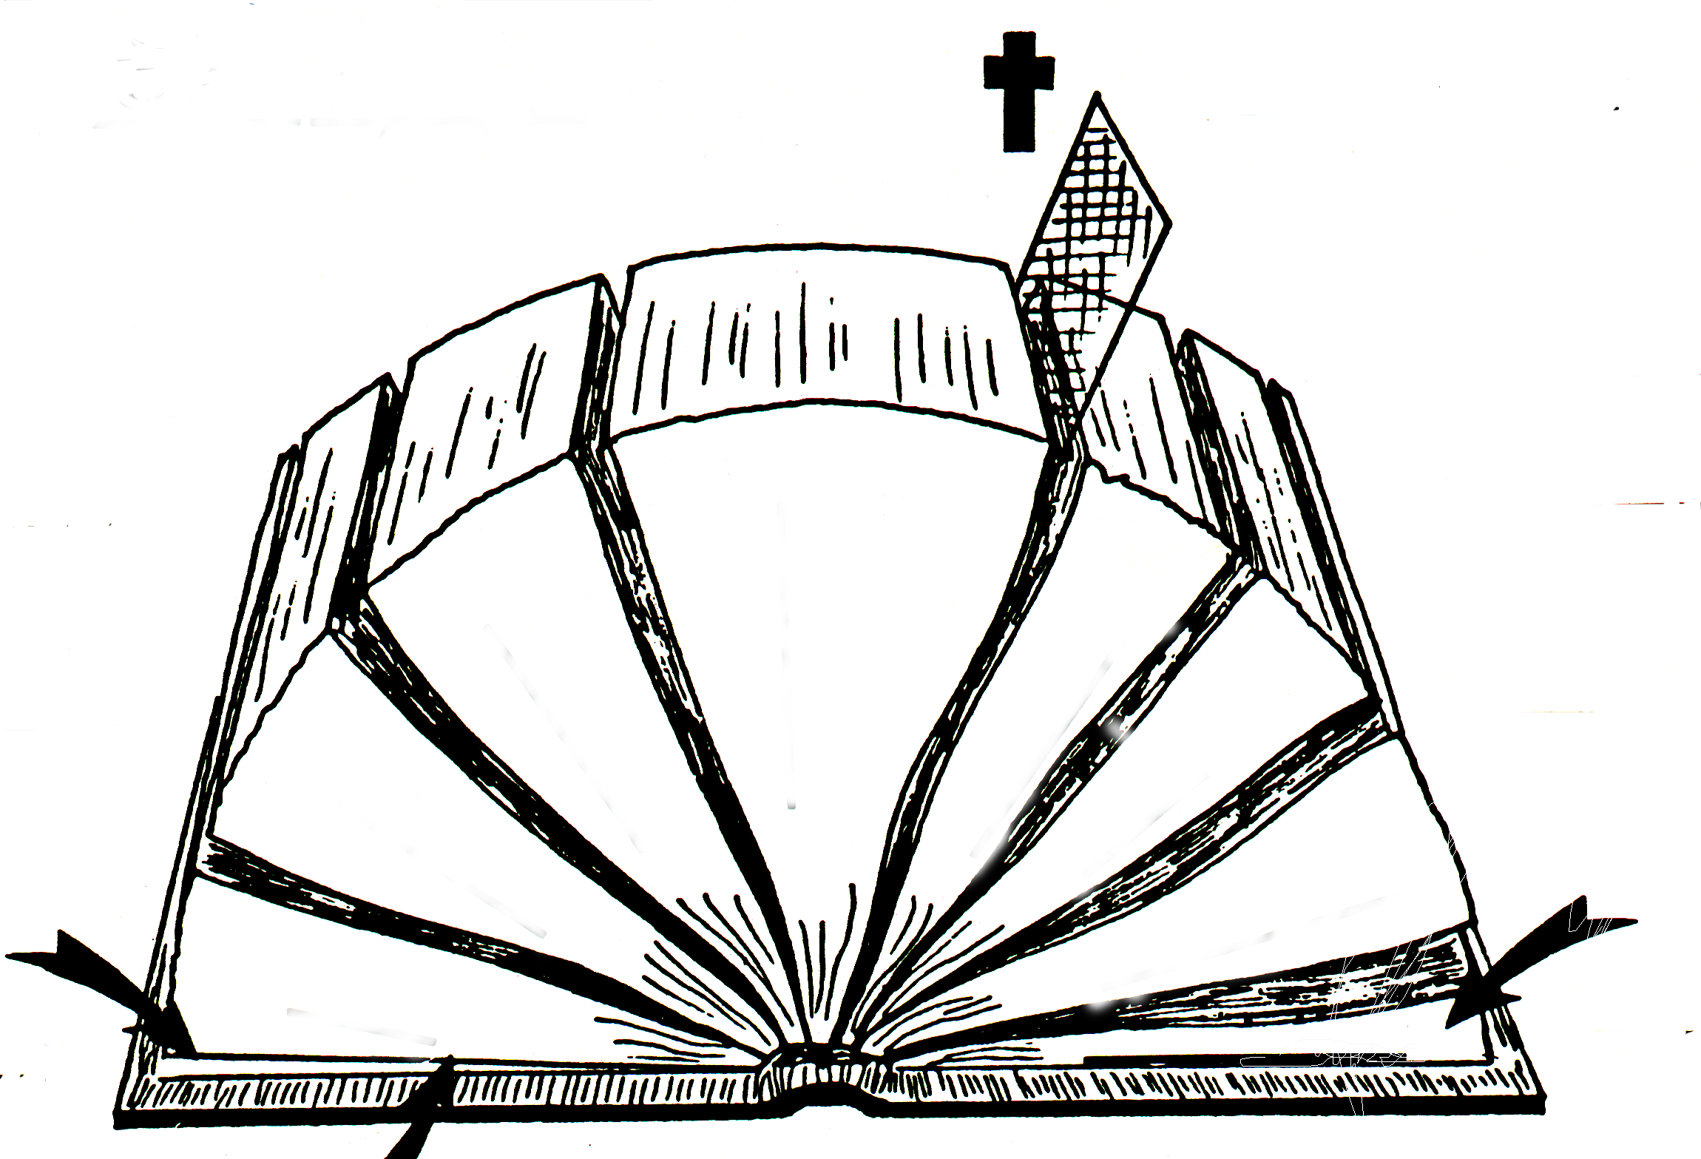
18
tibkfkpfpdfd Evtakmmf
_{1600 vRdgfkqf}
`
_{40 Nalaciaiyaf}
_{“pAzy” "bfpaD}
~
_{“p<tiy”} "bfpaD
:(p ")
;
oEr kBpfepaRqf:
"(p< ")
_{Etv{Ady mkiAm}
u(p "))
_{“39” p<tftkamf}
_(<p< "))
_{“27” p<tftkmf}
U(p ")
_{"piEryaf}
o(p< ")
_{kiErkfkiy}
4
/
3
5
_{`Rqf}
/
'(p ")
_{cdfdmf}
_{CviEcxmf}
O(p< ")
_{uBtiemazi}
_{tIafkfktaic[mf}
6
_{niAbEvRtlf}
2
_{‘'ZtfT}
_{`pfEpasftlaf}
_{caitftirmf}
7
_{niRpgfkqf}
1
_{cdfdmf}
_{evqipaD}
_{HISTORIES}
8
H(OT)
_{edlsfEkapf}
_{edlsfekapf}
H(NT)
_{edlisfEkapf}
J
2
1
_{kdnftkal nitftiymf}
_{Amkfkierasfekapf}
_{Amkfkierasfekapf}
_{vRgfkal nitftiymf}
I(OT)
pAzy & p<tiy "bfpaD ecylfpadfF[f obfBAm: niyaypfpirma[Mmf (1) mbfBmf CviEcxMmf (5) caitftir patipfAp u]fdakfkiyT, caitftirMmf (2) mbfBmf `pfEpasftl ndpFkfAkkQmf (6); klacfcartfti[f M[fE[bfbtfAt ka]fpitftT ; 'Ztfti[f uRvmf u]fdakfkiyT ; 'ZtfTkfkQmf (3) f niRpgfkQmf (7), nmfMAdy Evtakmtftilf ;r]fD viE[atma[ pakgfkqf vidfDec[fbiRkfkibT, ``tavT tIafkfktaic[Mmf (4) mbfBmf evqipfpDtfti[ viEcxMmf(8).

Slide 26
Seminar Study Help Number
19
p 7 ` ;
“p<tftkgfkAq oZgfK pDtfTtlf:”
pAzy "bfpadfAd vaiAcpfpDtfTtlf
p
pAdpfp<
1.
"rtftal kal kdfdmf: ki.M 2000 – M[fp<
Family Sin Flood Tower
~tiyakmmf
AC
~pirkamf
circa:
2.
"rtftal kal kdfdmf: ki.M 2000 – M[fp<
L-S-B Isaac Jacob 12 Sons
2.
Abra- ham
Eyap<
ALL OTHER “WRITINGS” ARE FROM THE “ROYALTY” PERIOD
EyaEcpfp<
1/2 David 1 Moses
3.
7.
"rtftal kal kdfdmf: ki.M 2000 – M[fp<
Slavery 430
cgfkitmf
4 m[itafkqf
kviAt (5)
niyaypfpirma[mf (5)
Solomon on Living
yatftrakmmf
7.
EmaEc
nIti.
4.
"rtftal kal kdfdmf: ki.M 2000 – M[fp<
Sinai M-C-C Kadesh 40 Years 5 Sermons
Elviyrakmmf
Solomon on Life
7.
']f]akmmf
pirc.
upakmmf
LC
7.
Solomon on Marriage
u[f[.
EyaCva
UNTANGLING THE PROPHETS:
5.
"rtftal kal kdfdmf: ki.M 2000 – M[fp<
Jericho/Ai Land Divided
EyaCva
TO ISRAEL (N. KINGDOM)
_{`rpiyavilf}
niyayatiptikqf
~Emasf
Ociya
_{~pr[gfkqf}
`rci[fAm
Eya[a (niA[Ev)
6.
"rtftal kal kdfdmf: ki.M 2000 – M[fp<
Judges 350 Years
Rtf
TO JUDAH (IN DECLINE)
*
1 caMEvlf
"caya
;sfrEvlf
(S)
EyaEvlf
3 cMtaygfkqf
caitftirmf (12)
raj ptvi
kIzfpFy
7.
"rtftal kal kdfdmf: ki.M 2000 – M[fp<
S-D-S SPLIT
2 caMEvlf
DC
mIka
N:North 10 Tribes Israel 20-J 200 Assyria
S:South 2 Tribes Judah 20-R 350 Babylon
(D)
}
optiya ("Etamf)
Ev]fDmf
1 ;rajakfkqf
(S)
*
TO JUDAH (IN CRISIS)
'REcElmilf
2 ;raj
NC
(CW)
*
'Ermiya
tIafkfktftaic]mf(17)
piriviA[kfK
piibfpaD
400 vRd
kaltftilf
f tIrfkfktricikqf
f 'Zti[arfkqf
mik
1 naqa.
p<lmfplf
( )
~pPkf
ctftma[
`FAmtft[mf
2 naqa.
(naPmf niA[Ev)
ctftma[paivdfdmf
8.
"rtftal kal kdfdmf: ki.M 2000 – M[fp<
70 Years 2 Tribes 100 Years 50,000 People Z-E-N
'sfba
enEkmiya
ecpfpa[iya
*
'sftaf
TO JUDAH (IN CAPTIVITY)
tpfpikfKmf
'Eckfkiylf
`
`Amti
*
AvkfkAr
9.
"rtftal kal kdfdmf: ki.M 2000 – M[fp<
Alex the Greek Roman Systems
©2006 John Fryman
ta[iEylf
TO JUDAH (IN RETURN)
prElartfti[f
;
;EyC
p<tiy "bfpaD GOSPELS…ACTS…EPISTLES…REVELATION
~kayf
TFpfp<mikfk
10.
"rtftal kal kdfdmf: ki.M 2000 – M[fp<
Life Cross Church
ckaiya
m[itafkqf
mlfkiya
A FINISHED VERSION IS PROVIDED AS STUDY HELP NUMBER 34.

Slide 27
20
p<tiy "bfpaD p<tftkgfkqi[f vaiAc
;EyCvi[f kakit EkaAvyilf… 100 vRd CviEcxMmf, ~ti tiRcfcApyi[f vrlaB. p<tiy "bfpadfFlf `dgfkiy<qfqT….
(4)
(1)
(21)
(1)
_{vivrgfkqf}
_{tiRcfcAp}
_{tiRcfcAp}
_{nitftiytfti[f}
__________&___________
____________ ____________
____________ ____________
____________ ____________
_{mt casftirmf}
_{caitftirmf}
_{']f]ikfAk}
_{vRgfkalmf}
CviEcxmf:
mtfEty<*
mabfK*
Lakfka*
Eyava[f
--------*
CRkfkmf:
“o[fbak
paaftftT”
`pfEpasftlRAdy ndpFkqf
niRpgfkqf
p<v<lidmiRnfT
vnft kFtgfkqf
Eramaf
1 ekaainftiyaf
2 ekaainftiyaf
klatftiyaf
'Epciyaf
pilipfpyaf
ekaElaecyaf
1 etcEla[ikfEkyaf
2 etcEla[ikfEkyaf
1 tIEmatfEty
2 tIEmatfEty
tItfT
piElEma[f
mbfbvafkqidmiRnfT vnft kFtmf:
'piEryaf
yakfEkay<
1 EpTR
2 EpTR
1 Eyava[f
2 Eyava[f
3 Eyava[f
y<ta
evqipfpDtfti[ viEcxmf
“cil
EramafkQkfK 2 ekaai uqfq[.”
“
“p<bjatiyaaf
“p[fbiAy
capfpiDvaafkqf
cAp epaRqaaai[f p<lmfplf: “EkaAzAdy ka]ikfAkyaqafkqf.”
“pv<li[f ;Bti kFtmf.f
'Rcelmilf ;[fbirv< 'piery etaAlkfkadfcfciyi[f p]iyadfkqf…
yakfEkap<,
EpTR,
Eyava[f,
y<ta
A FINISHED VERSION IS PROVIDED AS STUDY HELP NUMBER 35.

Slide 28

21
kaftftrakiy ;EyC kibisftfTAv Kbitft vR[A[
CviEcx 'ZtftaqaidmiRnfT : `vafkQAdy Kbipfpidfd ecviyaqafkqf…..ovfevaR CviEcxc p<tftktftilf `FpfpAd Enakfkgfkqf Pbpfpdfd[. ;EyC kibisfTvi[f ~zft[fAmAy Kbitft ovfevaR 'Ztftaqafkqi[f pAdpfp< viE[atmayf uqfqT…'ZtfTkfkqi[f kidfdtftdfd caiya[ tikti 'Ztpfpdfd[.
_{40s}
₆₄₋₆₈
_{_________ki.pi.}
_{_________ki.pi.}
1
_{mtfEty<}
2
_{mabfK}
_{Yy<tafkQkfK}
_{Eramafkqf}
yaRkfK:_________ yarak:__________ `vrf 'tA[:_________
yarkfK:_________ yarak:__________ `vrf 'tA[:_________
_{rajavak}
_{EvAlyaqf}
_{eca[f[aaf}
_{ecyftaaf}
_{CRkfkmf:}
_{“o[fbak ka[pfpdfdT”}
3
_{Lakfka}
4
_{Eyava[f}
_{kiErkfkiyaf}
_{tiRcfcAp}
yaRkfK: yarak: `vrf 'tA[: ________
yarkfK:_________ yarak:__________ `vrf 'tA[:_________
_{kdv<qf/m[it[f}
_{Kdv<qf}
: u[rfnfftarf
_{kRti[aaf}
₅₇₋₅₉
₆₉
_{_________ki.pi..}
_{_________ki.pi..}

Slide 29
22
Eyava[f CviEcxmf:
4
Eyava[f
Eyava[f o[fbamf `tikartftiliRnfT Tvkfk vc[gfkqf matftirmf paaftftalf EpaTmf
yaRkfK: tiRcfcAp
yarak: kdv<qf
`vrf
'tA[: `rftftmfeka]fdarf
;EyaC kibisfTAv Kbitft ~B pirta[ ctftiygfkqf!
• ;EyC: ;Rnftvrak ;Rnftvaf (v1)
• ;EyC: EvbfBAmy<qfqvaf (v1)
• ;EyC: Etv[ak ;RnftvRmf ;RpfpvRmf (v1)
• ;EyC: nitftiymayf EcafnfT ;Rpfpvaf (v2)
• ;EyC: ulktfAt pAdtftaaf (v3)
• ;EyC: oqikfKmf vazfvibfKmf kar]ma[vaf (v4,5,9)

Slide 30
23
3 pakgfkqilf kalmbfffb nikzfv<kqf
1
2
3
4
5
6
7
;EyCvi[f utftrv<mf , prEmRtLm,f
ep[fdkfekasfdf- tiRcfcApyi[f pibpfp< naqf cpfpa[i K]pfpdfdaaf
Mtlamf uptftirvmf
`[[iya cpfpIra
Mtlf utviyaqaf
sfEtva{mf uyiAr TbtfTtLmf
'RcElmilf
Chs. 1-7
pKti 1
palsftfTI[av<mf & ciaiyaliLmf
Chs. 8-12
8
9
10
11
12
pilipfp<mf, 'tftiEyapfpiy tAlv{mf
tmsfK caAlyilf cv<li[f ;rdfcfcipfp<
EpTRv<mf ekaafE[liy<mf
EpTR p<bjatiy Uziyai[f ecylfkAq- niRpikfkibaaf
"EraT kibisfTvafkAq uptftirvpDtfTtlf
pKti 2
13
14
15
16
17
18
19
20
21
22
23
24
25
26
27
28
Mtlf mix[ai py]mf
“
'RcElmf cgfkmf
;r]fdamf mix[ai py]mf
“
“
YM[fbamf mix[ai py]mf
“
pvlf< - 'RcElmilf
pvlf< - PdfdtftibfK M[fpak t[fA[ tbfkatftaaf
pv<lf – y>t cgfktftaRkfK M[fpak t[fA[ tbfkatftaaf
pv<lf – eplikfsfkfK M[fpak t[fA[ tbfkatftaaf
<pv<lf – epsfTv<kfK M[fpak tbfkatftaf
pv<lf - `kiaipfpa rajav<kfK M[fpak tbfkatftaf
Eramav<kfK py]mf – kpfplf viptfT
Eramavilf pv<lf
ulktftiLmf Chs. 13-28
pKti 3

Slide 31
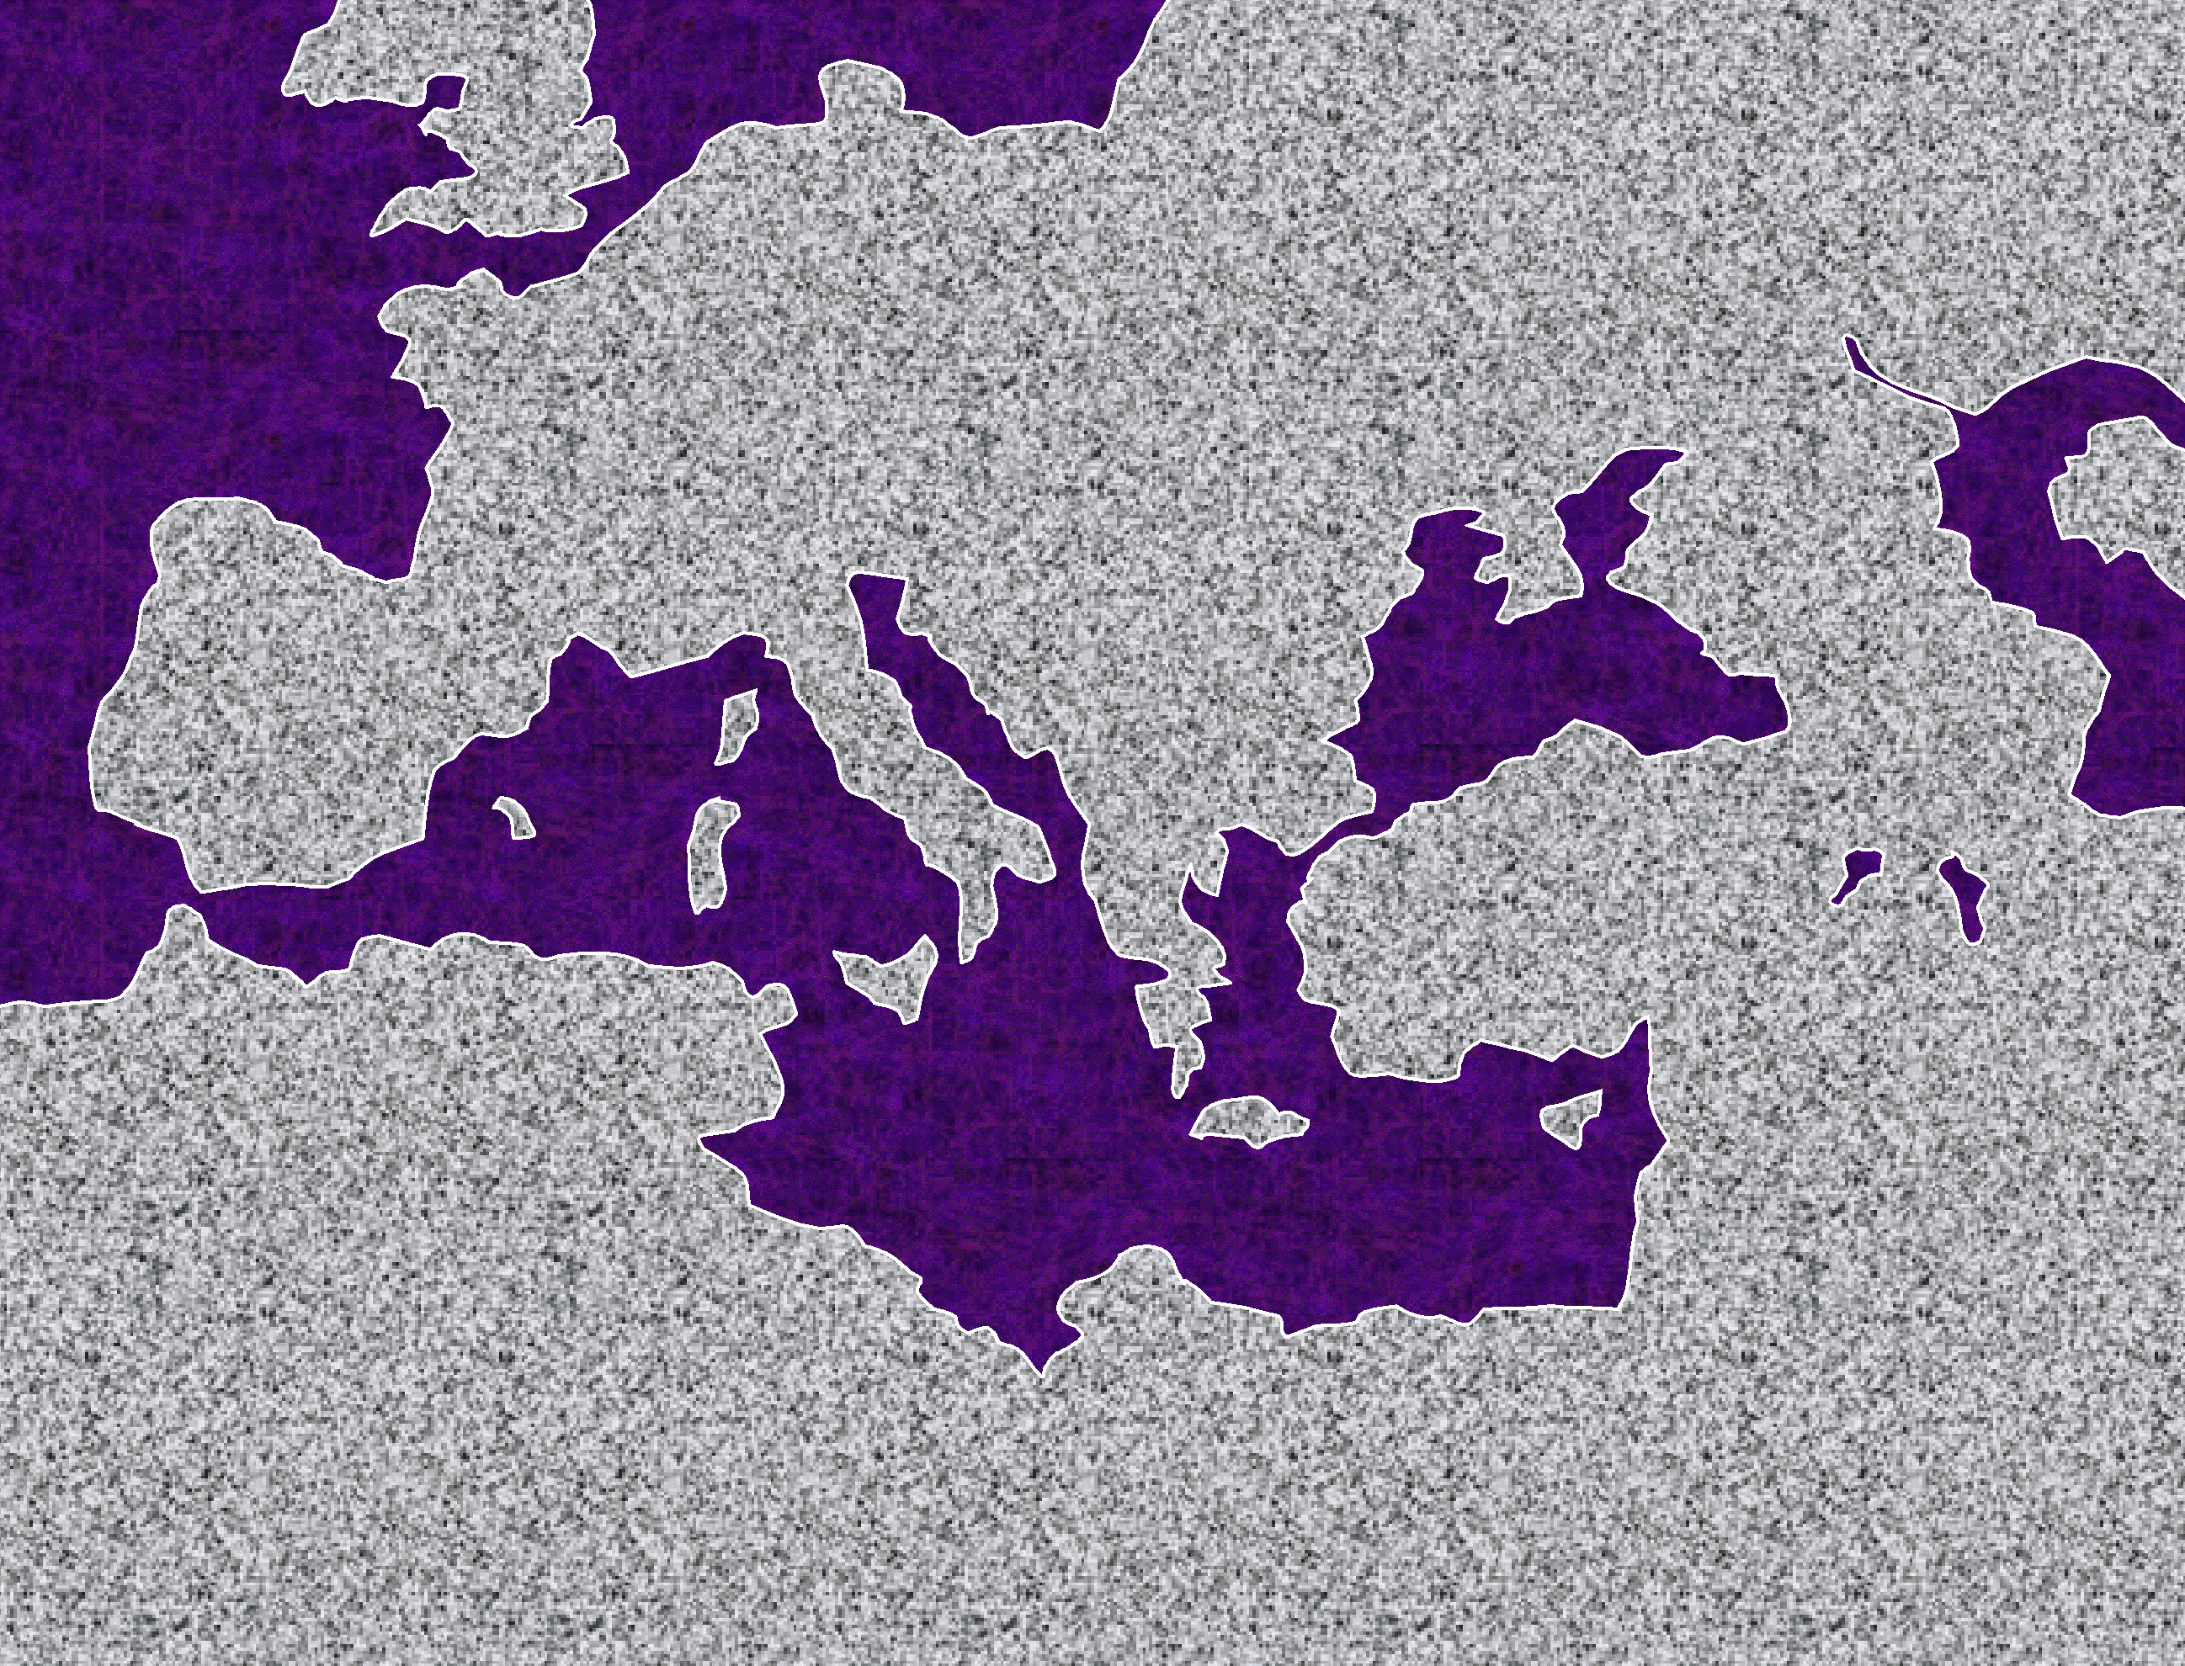


24
pv<lf-`vai[f py]tfti[f oR k]fE]adfdmf
_Erapfpa
1.“etadkfkmf : ~rayfcfci Pdarmf”
#1
`pfEpa 13-14
MkfkiytfTvmf : Etvafkqak v]gfki[aafkqf, `ticygfkqf ecyftaafkqf, pv<lf klfelbiypfpdfdaaf;kF[ma[ EvAl ;cAp sftapikfkpfpdfd[
•Eramf
ASIA
kirisf
•
•picitiya `nftiEyakf
tIafkfkpfpdfd kaaiygfkqf: kiRAp niyaypfpirma[mf `lfl
`tfEte[/ekarinfTH•
•cIriya `nftiEyakfH
'EpC
• 'RcElmf
~pfpirikfka
`rpiya
_Erapfpa
`pfEpa 15-18
`pfEpa 15
'RcElmf cgfkmf
•Eramf
~ciya
kirisf
• picitiya `nftiEyakf
2. “_Erapfpiy takfkmf”
#2
ATHENS/CORINTH•
• cIriya `nftiEyakfH
MkfkiytfTvmf : `E[k tiRcfcAmkqf sftapitftlf. mkfkEta[iyavibfK `Azpfp<, pibfpaD `tfEt{kfK; maafsf mAl; ekaainfTvilf nI]fd naqf tgfKtlf
'EpC
• 'RcElmf
~pfpirikfka
`rpiya
_Erapfpa
`pfEpa 18-21
3. “~ciyavi[f takfkmf”
#3
•Eramf
MkfkiytfTvmf:'EpC cApkqilf Pdtla[ kal `vkacmf. Mr]tftiliRnfT ;Alw[f 'Zpfppfpdfda[. 'EpC etazilf nip<[afkEqaD `rgfktftilf klvrmf
~ciya
kirisf
• picitiya `nftiEyakf
ATHENS/CORINTH•
• cIriya `nftiEyakfH
'EpC
• 'RcElmf
~pfpirikfka
`rpiya
_Erapfpa
`pfEpa 21-28
4. “EramavibfKmf pibfpaD lapMmf!”
#4
•Eramf
~ciya
MkfkiytfTvmf : Aktiyak EramavibfK `{pfppfpdfdaaf. cIcRAdy vIdfFLmf, ciAbcfcaAlyiLmf kibisfTvafkqilf vcIkrmf. ;Bti Mkfkiy kFtmf. Nlfl EparadfdtfAt EparaF, viCvactfAt katfTkfekaqf!”
kirisf
• picitiya `nftiEyakf
ATHENS/CORINTH•
• cIriya `nftiEyakfH
'EpC
• 'RcElmf
~pfpirikfka
`rpiya
A FINISHED VERSION IS PROVIDED AS STUDY HELP NUMBER 36.

Slide 32
25
pv<li[f ;r]fD Mkfkiyma[ ;Abyiylf ctftiygfkqf. kibisfTvafkqi[f cinftA[y<mf ecylfpaDkqi[f `FpfpAd
nItiyakfkpfpDtlf – pav KbfbtftiliRnfT viDtAly<mf…… nItima{kfKtLmf
(oR enaFyilf niAbEvRkir oR Enr cmfpvmf!)
~ti 15:6 `v[f kaftftAr viCvacitfta[f, `At `vaf `v{kfK nItiyak ']f]i[aaf.
Eramaf 5:16-18 EmLmf oRv[f pavwfecyftti[alf u]fda[ tIafpfp< Etv[f `RQmf :v<kfK opfpa[tlfl, `nfttf tIafpfp< oEr Kbfbtfti[imitftmf ~kfkiA[kfK 'TvayiRkfkibT. kiRApvrEma `Enk KbfbgfkAq nIkfki nItiviqgfKmf tIafpfp<kfK "TvayiRkfkibT. `lflamLmf, oRv{Ady mIBtli[aEl, `nft oRv[fYMlmayf , mr]mf ~]fDeka]fFRkfk, kiRApyi[f paip>r]tfAty<mf nItiyakiy :vi[f paip>r]tfAty<mf epBkibvafkqf ;EyC kibisfT '[f{mf oRvraEl jIvA[ `AdnfT ~Qvaafkeq[fpT `tik nicfcymaEm. ~Akyalf oEr mIBtli[aEl 'lfla m{xRkfKmf ~kfkiA[kfK "Tva[ tIafpfp< u]fdayibfB.
paiCtftmakfKtlf -- paiCtft kaaiytibfK upEyakikfkpfpd piaitfetDtftlf.
(etadafcfciya[, Mtafcfci `Adkib niAlkqf)
1 eka 1:2 ekaainfTviEl kibisfT ;EyCv<kfKqf paiCtftmakfkpfpdfdvafkqay<mf, paiCtftva[fkqaKmfpF `Azkfkpfpdfdvafkqay<miRkfkib Etv{Ady cApkfKmf, 'gfkQkfKmf tgfkQkfKmf ~]fdvrayiRkfkib nmfMAdy kaftftrakiy ;EyCkibisfTvi[f namtfAt 'gfKmf etaZTekaqfQkib `A[vRkfKmf 'ZTkibtavT.
2 eka 5:17 ;pfpFyiRkfk, orv[f kibisfTv<kfKqfqiRnftalf p<TcfciRxfFyayiRkfkiba[f, pAzyAvkqf ozinfTEpayi[, 'lflamf p<titayi[.
Eramaf 5: 1-4 ;vfvitmak, namf viCvaftfti[alf nItima[fkqakfkpfpdfFRkfkibpFyalf, nmfMAdy kaftftrakiy ;EyCkibisfTYMlmayf Etv[idtftilf cmata[mf epbfbiRkfkiEbamf. `vafYMlmayf namf ;nftkf kiRApyilf pirEvcikfKmf cilakfkitfAt vicvactfti[alf epbfB niAleka]fFRnfT, EtvmkiAmAy `AdEvaem[fkib nmfpikfAkyi[aEl Em[fAmparadfDkiEbamf. `Tmatftirmlfl, uptftirvmf epaBAmAyy<mf, epaBAm paIdfAcAyy<mf, paIdfAc nmfpikfAkAyy<mf u]fdakfKkibet[fB nagfkqf `binfT, uptftirvgfkqiEl Em[fAm paradfDkiEbamf

Slide 33
26
kFtgfkqi[f Mkfkiy kBpfepaRqf
Mtlavtak- pv<lidmiliRnfT vnft kFtgfkqf
Eramaf
1 ekaai
2 ekaai
klatftiyaf
'Epciyaf
iplipfpiyaf
ekaElciyaf
Enaftfti ecyftlf _________
tiRcfcApkqilf kibisfTvafkqi[f ndvFkfAk
pv<li[f `pfEpasftftl ttfTvtfti[f nijmf
kiRApyi[f vlflAm
viCvaciyi[f niAly<mf ndkfAky<mf
;EyC kibisfT nmfMAdy mkizfcfci
;EyC kibisfT MbfbiLmf EpaTma[vaf
_{viCvacmf}
1:17
1:2
12:9
3:2
1:3
4:4
2:10
1 etcEla
2 etcEla
1 tIEmatfEty<
2 tIEmatfEty<
tItfT
piElEma[f
'pieryaf
kAdci nadfkqi[f cmfpvgfkqf
kaftftai[f vRAkyi[f naqf
tiRcfcApyilf Enaftftiya[ oZgfK
CviEcxtfAt katfTkfekaqfQgfkqf, etadnfT pirciy<gfkqf
YMpfpafkqi[f tKtikqf
kibisfTv<kfKqf mbfbvafkAq "bfBekaqfQtlff
;EyC kibisfT mikfk EpaTma[vaf
1:10
1:6
2:8
1:13
2:1-2
v.17
1:4
yakfEkay<
1 EpTR
2 EpTR
1 Eyava[f
2 Eyava[f
3 Eyava[f
Yy<ta
`[fbad vazfkfAkyi[f viCvacmf kiaiAy ecyfkibT
kibisfTvafkqi[f vazfkfAky<mf kdAmkQmf
tiRcfcApyilf klfl Epatkafkqf
;rdfcfcipfp< nicfcymf. klfl Epatkafkqf KbitfT 'cfcaikfAk
kibisfTvi[f kdfdAqkqi[f pF ndv<gfkqf
Eyava[i[f `pfEpasftl `tikarmf
viCvactftibfK vataD
2:26
2:7
2:1
5:13
v. 3
vv. 4, 11
vv. 20-21
;r]fdavtak: mbfbvafkqidmiRnfT vnft kFtgfkqf

Slide 34
26a
EmLmf “kFtgfkqi[f” kBpfepaRqf
pv<li[f kFtmf
tItfT2:1-2
nIEya ~Erakfkima[ upEtctfTkfEkabfbAvkAqpf EpC. MtiafvyTqfq p<Rxafkqf jakfkirAty<qfqvafkQmf, nlfElaZkfkMqfqvafkQmf, etqinft p<tftiy<qfqvafkQmf, viCvatftiLmf `[fpiLmf epaBAmyiLmf ~ErakfkiyMqfqvafkQmayiRkfKpF p<tftiecalfL
Eramaf 1:17
viCvactfti[aEl nItima[f piAzpfpa[f '[fB 'ZtiyiRkfkibpF viCvactfti[alf u]fdaKmf EtvnIti viCvactftibfek[fB `nftcf Cviecxtfti[alf evqipfpDtftpfpDkibT
1 ekaainftiyaf 1:2
ekaainfTviEl kibisfT ;EyCv<kfKqf paiCtftmakfkpfpdfdvafkqay<mf, paiCtftva[fkqaKmfpF `Azkfkpfpdfdvafkqay<miRkfkib Etv{Ady cApkfKmf, 'gkQkfKmf tgfkQkfKmf ~]fdvrayirkfkib nmfMAdy kaftftrakiy ;EyC kibisfTvi[f namtfAt 'gfKmf etaZTekaqfQkib `A[vRkfKmf 'ZTkibtavT
piElEma[f 17-18
~tlalf, nIaf '[fA[ umfEmaEd _kfkiyma[ve[[fB ']f]i[alf, '[fA[ "bfBkfekaqfvTEpalf `vA[y<mf "bfBekaqfQmf. `v[f umkfK yaetaR `niyawfecyftTmf, umfmidtftilf kd[fpdfdTmf u]fda[alf, `At '[f k]kfkiEl AvtfTkfekaqfQmf
mbfbvafkqidmiRnfT vnft kFtgfkqf
2 ekaainftiyaf 12:9
`tbfK `vaf : '[f kiRAp u[kfKpfEpaTmf;plvI[tftiEl '[f plmf p>r]mayf viqgfKmf '[fbaaf. ~Akyalf, kibisfTvi[f vlflAm '[fEmlf tgfKmfpF, '[f plvI[gkAqkgfKbitfT na[f mikv<mf cnfEtaxmayf Em[fAmparadfDEv[f
'pieryaf 1:4
;vaf EtvTatArpfpaafkfkiLmf 'vfvqv<viEcxitft namtfAtcf CtnftaitfTkfeka]fdaEra, `vfvqv< `tikmayf `vafkqiLmf Em[fAmy<qfqvra[aaf.
yakfEkap< 2:26 `pfpFEy, ~viyilflat caIrmf ectfttayiRkfkibTEpal, kiaiAykqilflat viCvacMmf ectftatayiRkfkibT
klatftiyaf 3:2 o[fAbmatftirmf ugfkqidtftilf `biyviRmfp<kiEb[f:niyaypfpirma]tfti[f kiaiAykqi[aElEya, viCvackf Ekqfviti[aElEya, 'ti[aEl ~viAypf epbfIafkqf?
1 EpTR 2:7
~Akyalf viCvacikfkib ugfkQkfK `T viAlEybpfepbfbT, kIzfpfpFyamliRkfkibvafkQkfEka kdfDkibvafkqalf, tqfqpfpdfd pirta[ YMAlkfklflakiy `nftkf klf ;dBtbfEkTvak klfLmf viZtbfEkTva[ k[fmAly<mayibfB.
'Epciyaf 1:3
nmfMAdy kaftftrakiy ;EyC kibisfTvi[f pitavakiy Etv{kfK sfEtatftirmf, `vaf kibisfTv<kfKqf u[f[tgfkqiEq ~vikfKaiy ckl ~cIafvattfti[aLmf nmfAm ~cIafvtitftiRkfkibaaf
2 EpTR 2:1
kqfqtftIaftfttaicikQmf j[gfkQkfkqfEq ;Rnftaafkqf, `pfpFEy ufgkQkfKqfQmf kqfqpfEpatkqfkqf ;Rpfpaafkqf. `vafkqf EkdfDkfEkTva[ Ectpfp<rdfDkAqtf tnftirmayf NAzypfp]f]I, tfgkAqkf kirytfTkfKkfeka]fd ~]fdvAr mBtlitfT, tgfkQkfKtf tIvirma[ `ziAy vRvitfTkfekaqfQvaafkqf
pilipfpiyaf 4:4
kaftftRkfKqf 'pfEpaZTmf cnfEtaxmayiRgfkqf. cnfEtaxmayiRgfkqf '[fB mBpFy<mf ecalfLkiEb[f
ekaEkaecyaf 2:10
…EmLmf ckl TArtft[gfkQkfKmf `tikartfTkfKmf tAlvrayiRkfkib `vRkfKqf nIgfkqf paip>r]MqfqvafkqayiRkfkibIkqf
1 Eyava[f 5:13
ugfkQkfK nitftiyjIv[f u]fed[fB nIgfkqf `biyv<mf, EtvKmar{Ady namtfti[f Emlf nIgfkqf viCvamayiRkfkv<mf, EtvKmar{Ady namtfti[f Emlf viCvacmayiRkfkib ugfkQkfK ;Avkqf 'ZtiyiRkfkiEb[f
1 etcEla[ikfEkyaf 1:10
;EyC prElaktftiliRnfT vRvAt nIgfkqf 'tiafpaaftfTlfeka]fFRkfkibAty<mf `bivikfkibaafkEq.
2 Eyava[f v.3
Pitavikiy Etv{Lmf pitavi[f Kmar[ayiRkfkib kaftftrakiy ;EyCkibisfTvi[aLmf, kiRApy<mf ;rkfkMmf cmata[Mmf, ctftiytfEtaDmf `[fEpaDgfPd ugfkEqaFRpfptak.
2 etcEla[ikfEkyaf 1:6
ugfkAq uptftirvpfpDtfTkibvafkQkfK uptftrvtfAty<mf, uptftirvpfpDkib ugfkQkfK “
'gfkEqaEdPd ;AqpfpaBtAly<mf pirtipl[aktf ekaDpfpT Etv{kfK nItiyayiRkfkibEt.
3 Eyava[f vs 4; 11
'[f piqfAqkqf ctftiytftiEl ndkfkibaafkqf '[fB EkqfvipfpDkib cnfEtaxtftiLmf `tikma[ cnfEtaxmf '[kfK ;lfAl. Piaiyma[vE[, nI tIAmya[Atpf pi[fpbfbamlf, n[fAmya[Atpf pi[fmbfB, n[fAmecyfkibv[f Etv[alf u]fdayiRkfkiba[f, tIAmecyfkibv[f EtvA[kf ka]vilfAl
1 tIEmatfEty< 2:8
I`[fbiy<mf p<Rxafkqf EkapMmf tafkfkMmilflamlf paiCtftma[ AkkAq uyaftfti, 'lfla ;dgfkqiEly<mf ejpmf p]f]Ev]fem[fB viRmfp<kiEb[f.
y>ta: vs. 20-21
nIgfkEqa piaiyma[vafkEq, ugfkqf mka paiCtftma[ viCvactfti[eEmlf ugfkAq uBtipfpDtftikfeka]fD, paiCtft ~vikkfKqf ejpmfp]f]I, Etv{Ady `[fpiEl ugfkAqkf katfTkfeka]fD nitftiy jIv{kfEkTvak nmfMAdy kaftftrakiy ;EyCkfkibisfTvi{Ady ;rkfktfAtpfepbkf katftiRgfkqf.
2 tIEmatfEty< 1:13
nI kibisfT ;EyCAvpfpbfBmf viCvavtfEtaDmf `[fEpaDmf '[f[idtftilf EkdfFRkfkib ~Erakfkiyma[ vc[gfkqi[f cdfdtfAtkf Akkfkeka]fFR.

Slide 35
27
`pfEpasftlaf Eyava[idmiRnfT:
vRgfkal nitftiytfAt Kbitft oR k]fE]adfdmf
evqipfpDtfti[ viEcxmf
kFtgfkqf MtftiArkqf 'kfkaqgfkqf klcgfkqf
viCvastfAt vidfd cAp
YkibisfTvi[f vRAk
~dfDkfKdfFya[vai[f tiRm] viRnfT evqi 19:1-10
;EyC kibisfTvi[f ;r]fdamf vRAk evqi 19:11-16
evqipfpDtfti[ viEcxtftilf jnfT ~tar Kbipfp<kqf 19, 20, 21
kibisfTvi[f p>Elak `rcadfci evqi 20:4-6
evqfAq cifgfkac[tfti[f niyaytftIafpfp< evqi 20:11-15.
Cmaaf 95 ki.pi , "jiy[f kdliLqfq ptfEmasf tIv<kqiliRnfT 'ZtpfpdfdAvkqf
p<tiy va[Mmf p<tiy p>miy<mf ____________ evqi 21:1-8

Slide 36
28
Evtakmtfti[f kdnft kal enyfy<tlf
p 7 ` ;
~pirkami[f ud]fpFkfAk
Etc ud]fpFkfAk
tavIti[f ud]fpFkfAk
p<tiy ud]fpFkfAk
~pirakMkfK ekaDkfkpfpdfd vakfKtftgfkkqf niAbEvaikfeka]fFRkfKmfEpaT, Evtakm cmfpvgfkQmf M[fE[bieka]fFRnftT:
•~pirkami[f `AztftLmf, ~tiyakmmf 12 , 15 ud[fpFkfAky<mf
• upakmmf 30lf,Etcmf ( plsftftI[a) ud[fpFkfSky<mf
• 2 caMEclf 7 lf, tavIti[f ud[fpFkfAky<mf
• 'Ermiya 31lf, p<tiy ud]fpFkfAky<mf.

Slide 37
29
vKpfpilf ma]vafkqf p>aftfti ecyfyEv]fFy M[f[alf TA[ padtftilf, ;pfEpa MZAmya[ ptilfkEqaD ;[f vRki[fb pkfkgfkqilf k]fDkfekaqfqlamf.~[aLmf ‘p>aftftiecyfy<mf” tbfkAq py[fpDtft ugfkAq ubfcfcakpfpDtfTkiEbamf. ;pfpF ecyfvti[alf, ;pfpadtf tidfdmf `tik n[fAm `qikfKmf

Slide 38
30
Evtakm niAlAy `Amtftlf
ni
m.k
~
k
k.k
'
En.ma
_.n
pa
'
u(k)
k.p
ecylfpaF[f
u
cI.m
“
paAtkqf”
p.v
ci.c
kAtyi[f paAtAy EcaftfTkfekaqfQtlf”
ni
m.k
~
k
k.k
_.n
'
E.k
pa
u(k)
'
“
ecylfpaF[f
u
k.p
cIma
paAtkqf
p.v
ci.c

Slide 39
31
Evtakm kakit EkaAvyi[f KbipfpiDtlf
pAdpfp<
`rci[fAm
1mf ~]f & ep]f
niyatiptikqf
1mf pavmf
350
p
1mf upEtcmf
p
7
` ;
1mf KDmfpmf
rajpf ptvi
(1000 ki. M.)
1mf ekaAl
S - D - S
_{DC}
evqfqmf/va[vilf
••• pirinft[•••
EkadfAd
vdkfK etbfK
~pirkamf
(2000 ki.M)
;sfrEvlf y<>ta
`Azpfp<
_{AC}
10 2
_{NC}
L - S - B
tIafkfktaici
I - I
20-J 20-R
3 cMtaygfkqf
200 350
J - E
`ciaiya papiEla[f
12
EyaEcpfp<
`FAmtft[mf
70 vRdgfkqf
`FAmtft[mf
3 pirya]mf
430
100 vRdgfkqf/50,000
Z - E - N
EmaEc
(1500 ki. M)
`Amti
yatftirakmmf
`
(500 B.C.)
4 m[itrfkqf
kiErkfkiy `elkfsf
cI[ayf
Eram Mabkqf
M - C - C
_{kaEdxf prf[iya}
;EyC
40
_{LC}
vazfkfAk
5 upEtcmf
;
ciLAv
_{EyaCva}
tiRcfcAp
upEtcmf
_{'aiEka / ~yf}
`pfEpasftftlaf
_{Etcmf pKkfkpfpdfd[}
niRpgfkqf
evliipfpDtfti[
CviExcmf
THIS PAGE, INCLUDING THE COPYRIGHT NOTICE, MAY BE REPRODUCED LOCALLY FOR STUDY AND TEACHING PURPOSES.

Slide 40
32
~pirkamibfK ~tiyakm vakfKttftgfkqf
Evtakm evqipaDkqi[f “ MTekZmfp<”
~pirkaAm `Aztftlf ~ti 12:1-3
~pirkami[f ud[fpFkfAk
ud[fpFkfAk ~ti 15:9-18
~pirkami[f ud[fpFkfAkyi[f Mkfkiy cibpfpiylfp<
nipnftA[ybfb ~trv<
nitftiymf
caiya[Av
~ti 13:15
~ti 13:14-16
~ti 15:9-18
nilmf
__________
viAt
~ciafvatmf
~ti 12:2
~ti 12:3
~ti 12:1
Gen ___:___
nilmf
Taviti[f
p<tiy
opfpnftmf
opfpnftmf
opfpnftmf
Deut 30:1-10
2 caM 7:14-16
"Er 31:31-34
epBkcfecyfypfpdfd ciB ud[fpFkfAkkqf
A FINISHED VERSION IS PROVIDED AS STUDY HELP NUMBER 32.

Slide 41
33
tibkfkpfpdfd Evtakmmf
_{1600 vRdgfkqf}
`
_{40 Nalaciaiyaf}
_{“pAzy” "bfpaD}
~
_{“p<tiy”} "bfpaD
:(p ")
;
oEr kBpfepaRqf:
"(p< ")
_{Etv{Ady mkiAm}
u(p "))
_{“39” p<tftkamf}
_(<p< "))
_{“27” p<tftkmf}
U(p ")
_{"piEryaf}
o(p< ")
_{kiErkfkiy}
4
/
3
5
_{`Rqf}
/
'(p ")
_{cdfdmf}
_{CviEcxmf}
O(p< ")
_{uBtiemazi}
_{tIafkfktaic[mf}
6
_{niAbEvRtlf}
2
_{‘'ZtfT}
_{`pfEpasftlaf}
_{caitftirmf}
7
_{niRpgfkqf}
1
_{cdfdmf}
_{evqipaD}
_{HISTORIES}
8
H(OT)
_{edlsfEkapf}
_{edlsfekapf}
H(NT)
_{edlisfEkapf}
J
2
1
_{kdnftkal nitftiymf}
_{Amkfkierasfekapf}
_{Amkfkierasfekapf}
_{vRgfkal nitftiymf}
I(OT)
pAzy & p<tiy "bfpaD ecylfpadfF[f obfBAm: niyaypfpirma[Mmf (1) mbfBmf CviEcxMmf (5) caitftir patipfAp u]fdakfkiyT, caitftirMmf (2) mbfBmf `pfEpasftl ndpFkfAkkQmf (6); klacfcartfti[f M[fE[bfbtfAt ka]fpitftT ; 'Ztfti[f uRvmf u]fdakfkiyT ; 'ZtfTkfkQmf (3) f niRpgfkQmf (7), nmfMAdy Evtakmtftilf ;r]fD viE[atma[ pakgfkqf vidfDec[fbiRkfkibT, ``tavT tIafkfktaic[Mmf (4) mbfBmf evqipfpDtfti[ viEcxMmf(8).

Slide 42
34
p 7 ` ;
“p<tftkgfkAq oZgfK pDtfTtlf:”
p
pAdpfp<
pAzy "bfpadfAd vaiAcpfpDtfTtlf
1.
"rtftal kal kdfdmf: ki.M 2000 – M[fp<
Family Sin Flood Tower
~tiyakmmf
AC
~pirkamf
circa:
2.
"rtftal kal kdfdmf: ki.M 2000 – M[fp<
L-S-B Isaac Jacob 12 Sons
2.
Abra- ham
Eyap<
ALL OTHER “WRITINGS” ARE FROM THE “ROYALTY” PERIOD
EyaEcpfp<
1/2 David 1 Moses
3.
7.
"rtftal kal kdfdmf: ki.M 2000 – M[fp<
Slavery 430
cgfkitmf
4 m[itafkqf
kviAt (5)
niyaypfpirma[mf (5)
Solomon on Living
yatftrakmmf
7.
EmaEc
nIti.
4.
"rtftal kal kdfdmf: ki.M 2000 – M[fp<
Sinai M-C-C Kadesh 40 Years 5 Sermons
Elviyrakmmf
Solomon on Life
7.
']f]akmmf
pirc.
upakmmf
LC
7.
Solomon on Marriage
u[f[.
EyaCva
UNTANGLING THE PROPHETS:
5.
"rtftal kal kdfdmf: ki.M 2000 – M[fp<
Jericho/Ai Land Divided
EyaCva
TO ISRAEL (N. KINGDOM)
_{`rpiyavilf}
niyayatiptikqf
~Emasf
Ociya
_{~pr[gfkqf}
`rci[fAm
Eya[a (niA[Ev)
6.
"rtftal kal kdfdmf: ki.M 2000 – M[fp<
Judges 350 Years
Rtf
TO JUDAH (IN DECLINE)
*
1 caMEvlf
"caya
;sfrEvlf
(S)
EyaEvlf
3 cMtaygfkqf
caitftirmf (12)
raj ptvi
kIzfpFy
7.
"rtftal kal kdfdmf: ki.M 2000 – M[fp<
S-D-S SPLIT
2 caMEvlf
DC
mIka
N:North 10 Tribes Israel 20-J 200 Assyria
S:South 2 Tribes Judah 20-R 350 Babylon
(D)
}
optiya ("Etamf)
Ev]fDmf
1 ;rajakfkqf
(S)
*
TO JUDAH (IN CRISIS)
'REcElmilf
2 ;raj
NC
(CW)
*
'Ermiya
tIafkfktftaic]mf(17)
piriviA[kfK
piibfpaD
400 vRd
kaltftilf
f tIrfkfktricikqf
f 'Zti[arfkqf
mik
1 naqa.
p<lmfplf
( )
~pPkf
ctftma[
`FAmtft[mf
2 naqa.
(naPmf niA[Ev)
ctftma[paivdfdmf
8.
"rtftal kal kdfdmf: ki.M 2000 – M[fp<
70 Years 2 Tribes 100 Years 50,000 People Z-E-N
'sfba
enEkmiya
ecpfpa[iya
*
'sftaf
TO JUDAH (IN CAPTIVITY)
tpfpikfKmf
'Eckfkiylf
`
`Amti
*
AvkfkAr
9.
"rtftal kal kdfdmf: ki.M 2000 – M[fp<
Alex the Greek Roman Systems
©2006 John Fryman
ta[iEylf
TO JUDAH (IN RETURN)
prElaktfti[f
;
;EyC
p<tiy "bfpaD GOSPELS…ACTS…EPISTLES…REVELATION
~kayf
TFpfp<mikfk
10.
"rtftal kal kdfdmf: ki.M 2000 – M[fp<
Life Cross Church
ckaiya
m[itafkqf
mlfkiya
A FINISHED VERSION IS PROVIDED AS STUDY HELP NUMBER 19

Slide 43
35
p<tiy "bfpaD p<tftkgfkqi[f vaiAc
;EyCvi[f kakit EkaAvyilf… 100 vRd CviEcxMmf, ~ti tiRcfcApyi[f vrlaB. p<tiy "bfpadfFlf `dgfkiy<qfqT….
(4)
(1)
(21)
(1)
_{vivrgfkqf}
_{tiRcfcAp}
_{tiRcfcAp}
_{nitftiytfti[f}
__________&___________
____________ ____________
____________ ____________
____________ ____________
_{mt casftirmf}
_{caitftirmf}
_{']f]ikfAk}
_{vRgfkalmf}
CviEcxmf:
mtfEty<*
mabfK*
Lakfka*
Eyava[f --------*
CRkfkmf: “o[fbak
paaftftT”
`pfEpasftlRAdy ndpFkqf
niRpgfkqf
p<v<lidmiRnfT
vnft kFtgfkqf
Eramaf
1 ekaainftiyaf
2 ekaainftiyaf
klatftiyaf
'Epciyaf
pilipfpyaf
ekaElaecyaf
1 etcEla[ikfEkyaf
2 etcEla[ikfEkyaf
1 tIEmatfEty
2 tIEmatfEty
tItfT
piElEma[f
mbfbvafkqidmiRnfT vnft kFtmf:
'piEryaf
yakfEkay<
1 EpTR
2 EpTR
1 Eyava[f
2 Eyava[f
3 Eyava[f
y<ta
evqipfpDtfti[ viEcxmf
“cil
EramafkQkfK 2 ekaai uqfq[.”
“
“p<bjatiyaaf
“p[fbiAy
capfpiDvaafkqf
cAp epaRqaaai[f p<lmfplf: “EkaAzAdy ka]ikfAkyaqafkqf.”
“pv<li[f ;Bti kFtmf.f
'Rcelmilf ;[fbirv< 'piery etaAlkfkadfcfciyi[f p]iyadfkqf…
yakfEkap<,
EpTR,
Eyava[f,
y<ta

Slide 44
36
pv<lf-`vai[f py]tfti[f oR k]fE]adfdmf
_Erapfpa
1.“etadkfkmf : ~rayfcfci Pdarmf”
#1
`pfEpa 13-14
MkfkiytfTvmf : Etvafkqak v]gfki[aafkqf, `ticygfkqf ecyftaafkqf, pv<lf klfelbiypfpdfdaaf;kF[ma[ EvAl ;cAp sftapikfkpfpdfd[
•Eramf
ASIA
kirisf
•
•picitiya `nftiEyakf
tIafkfkpfpdfd kaaiygfkqf: kiRAp niyaypfpirma[mf `lfl
`tfEte[/ekarinfTH•
•cIriya `nftiEyakfH
'EpC
• 'RcElmf
~pfpirikfka
`rpiya
_Erapfpa
`pfEpa 15-18
`pfEpa 15
'RcElmf cgfkmf
•Eramf
~ciya
kirisf
• picitiya `nftiEyakf
2. “_Erapfpiy takfkmf”
#2
`tfEte[/ekarinfTH •
• cIriya `nftiEyakfH
MkfkiytfTvmf : `E[k tiRcfcAmkqf sftapitftlf. mkfkEta[iyavibfK `Azpfp<, pibfpaD `tfEt{kfK; maafsf mAl; ekaainfTvilf nI]fd naqf tgfKtlf
'EpC
• 'RcElmf
~pfpirikfka
`rpiya
_Erapfpa
`pfEpa 18-21
3. “~ciyavi[f takfkmf”
#3
•Eramf
MkfkiytfTvmf:'EpC cApkqilf Pdtla[ kal `vkacmf. Mr]tftiliRnfT ;Alw[f 'Zpfppfpdfda[. 'EpC etazilf nip<[afkEqaD `rgfktftilf klvrmf
~ciya
kirisf
• picitiya `nftiEyakf
`tfEte[/ekarinfTH •
• cIriya `nftiEyakfH
'EpC
• 'RcElmf
~pfpirikfka
`rpiya
_Erapfpa
`pfEpa 21-28
4. “EramavibfKmf pibfpaD lapMmf!”
#4
•Eramf
~ciya
MkfkiytfTvmf : Aktiyak EramavibfK `{pfppfpdfdaaf. cIcRAdy vIdfFLmf, ciAbcfcaAlyiLmf kibisfTvafkqilf vcIkrmf. ;Bti Mkfkiy kFtmf. Nlfl EparadfdtfAt EparaF, viCvactfAt katfTkfekaqf!”
kirisf
• picitiya `nftiEyakf
`tfEte[/ekarinfTH
• cIriya `nftiEyakfH
'EpC
• 'RcElmf
~pfpirikfka
`rpiya

Slide 45
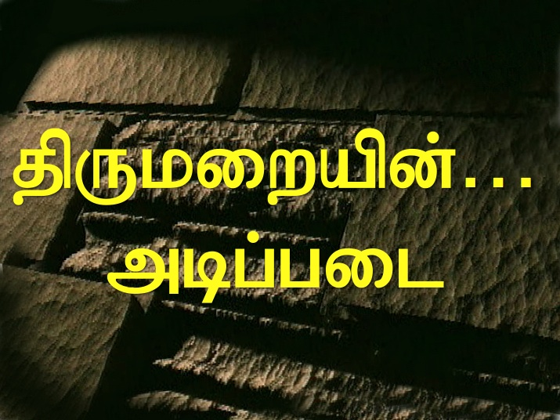
The Bible…Basically Ministries International Inc.
v: 817-346-4750 c: 817-300-6492 www.biblebasically.com johnfryman@earthlink.net
Ugfkqf pirtiy<tftirmf…
nIgfkqf ‘Evtakmf…. `FpfpAd pFtfTekaDtft `{pvtfAt M[f[idfD, 'gfkQkfK ugfkQAdy pirtiy<tftirtfAt kIzf ka{mf ;dtftilf 'Zt tazfAmEyaD EkdfDkfekaqfkiEbamf. Ugfkqf kRtfTkqf eka]fD, ;pfpadtfti[f uqfqdkfkgfkQmf, UziyMmf caipfpDtft "TvayiRkfKm. nIgfkqf viRmfpi[alf, ugfkqf epyaf, vilacmf, ;-Emlf 'gfkQkfK `{pfplamf. ugfkQkfK 'gfkQAdy Uziytfti[f vivrgfkAq ugfkQkfK etaiypfpDtfTEvamf
;nft vKpfpi[f EnrtfAt KbitfT '[f[ niA[kfkibIakqf
( )mik nI]fd Enrmf ( )nI]fd Enrmf ( ) ;]f}mf nI[fd Enrmf ( ) nI]fd Enrmf `vciymf
epyaf:________________________________________________
vilacmf:______________________________________________
______________________________________________________
______________________________________________________
;Emlf vilacmf:_________________________________________ PLEASE PRINT ALL INFORMATION!
Multiplying Biblical Literacy Throughout The Body of Christ

Slide 46
The Bible…Basically Ministries International Inc.
v: 817-346-4750 c: 817-300-6492 www.biblebasically.com johnfryman@earthlink.net
ugfkqf cil vaaftfAtkqf utviyakyiRkfKmf!
mbfb UziygfkqiEla `lflT tiRcfcAyi[f npafkQkfK, ;nft Evtakm… `FpfpAd padmf pirEyaj[mayikfKmf '[fB nIgfkqf niA[tfT `biMkpfpDtfTvti[f YMlmf 'gfkqf UziytftibfK nIgfkqf epBmf utviyak ;RpfpIafkqf. ;pfpadtfAt ndtfTvtbfK `vafkqf etadafp<ekaqfq, nIgfkqf ugfkqf cpaafC ecyfy Ev]fFkfekaqfkiEbamf
sftap[tfti[f epyaf:____________________________________
;dmf :_________________________________________
etadafp< ekaqfq Ev]fFy npaf:______________________________________
ugfkqf epyAr py[fpDtft `{mti?____________
sftap[tfti[f epyaf:____________________________________
;dmf :_________________________________________
etadafp< ekaqfq Ev]fFy npaf:______________________________________
ugfkqf epyAr py[fpDtft `{mti?____________
sftap[tfti[f epyaf:____________________________________
;dmf :_________________________________________
etadafp< ekaqfq Ev]fFy npaf:______________________________________
ugfkqf epyAr py[fpDtft `{mti?____________
sftap[tfti[f epyaf:____________________________________
;dmf :_________________________________________
etadafp< ekaqfq Ev]fFy npaf:______________________________________
ugfkqf epyAr py[fpDtft `{mti?____________
Multiplying Biblical Literacy Throughout The Body of Christ

